Slide 1
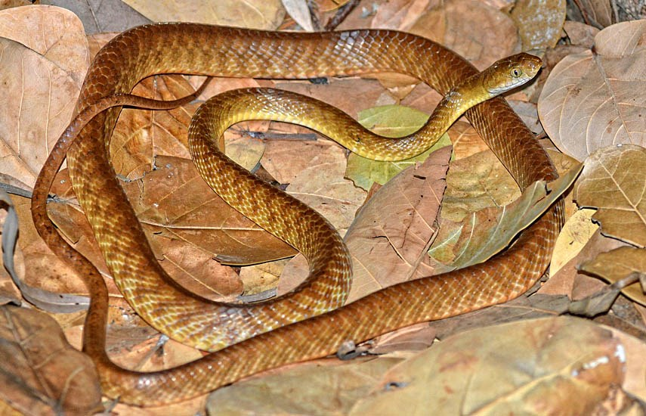
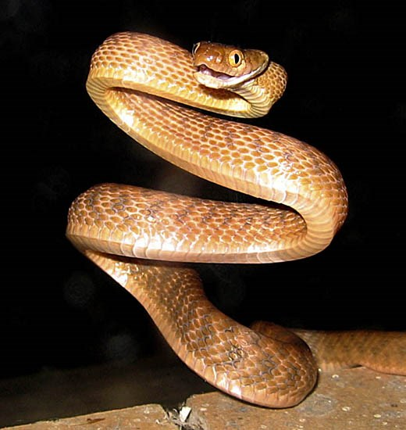
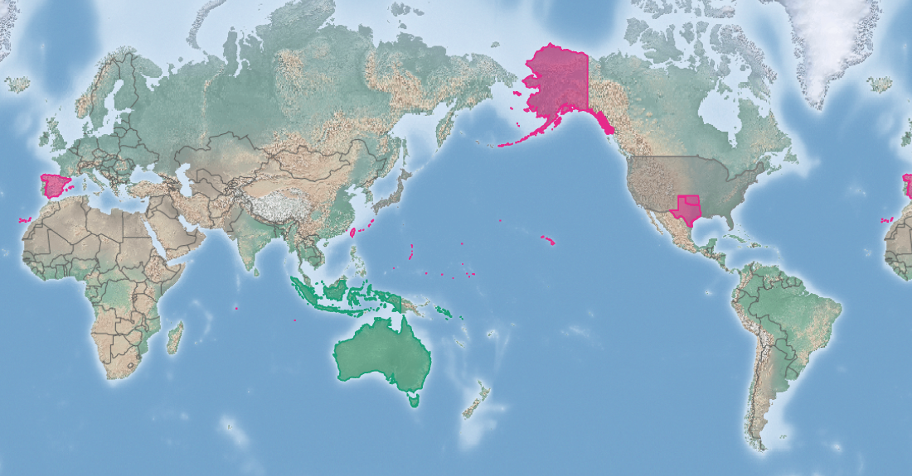
Brown tree snake
Boiga irregularis
KEY FEATURES
A slender, climbing snake with large eyes and a vertical pupil in the eye
The head is wider than the neck. Markings may be either vague or distinct blotches on a brownish-yellow background. Some can have black speckling
The snakes are 38 cm long at hatching and can reach three metres, but are usually 1-2 metres
They are skilful climbers and can crawl through very small openings
The female produces 4-12 oblong eggs, 42-47 mm long and 18-22 mm wide. The eggs have a leathery shell and often stick together. Two clutches of eggs can be produced each year
Eggs are laid in hollow logs, rock crevices and other sites where they are likely protected from drying and high temperatures
The female snake can store sperm and produce eggs over several years after mating
Brown tree snake is mildly poisonous. The venom trickles slowly into a bite victim from rear fangs. It will readily strike when annoyed, but is not a danger to adults. The snake can coil around babies. Babies and children who are bitten must get emergency medical treatment
PATHWAYS ✓ shipping/military ✓ biological control ✓ pet trade
Introduced
Native
Origin not
recorded

Slide 2






Brown tree snake
Boiga irregularis
IMPACTS
Environment
Health
Society &
Culture
Economy
Has caused extinction of more than half of Guam’s native birds & lizards and two of Guam’s three bats. Loss of these pollinators caused "cascading" effects on ecosystems, reducing plant regeneration, diversity and coverage
Mildly venomous, the snake is a potential health hazard to infants and young children. Responsible for 1/1000 hospital emergency visits on Guam. Also danger of increased disease from insects that were previously eaten by native animals
None specifically reported, but animals that may have been important culturally are no longer seen on Guam
Power outages caused by snakes have been a serious problem on Guam. Fear of the brown tree snake may cause tourists to avoid Guam. An agricultural pest.
DISTRIBUTION
Native range Eastern Indonesia, New Guinea, Solomon Islands and the coastal areas of northern and eastern Australia
Introduced range The population on Guam is the only confirmed breeding population outside of its native range, although it may be established on Saipan. Encounters have been reported from Micronesia, United States mainland, Hawai’i and the Commonwealth of the Northern Mariana Islands
ADDITIONAL NOTES
INFORMATION SOURCES (click links for more)
Images ©Alexandre Roux/via flickr - CC BY-NC-SA 2.0 (top) Public Domain - Released by Soulgany101 at the English Wikipedia project (bottom)
Text, images Boiga irregularis (brown tree snake) – CABI and map https://www.cabi.org/isc/datasheet/91542

