Slide 1
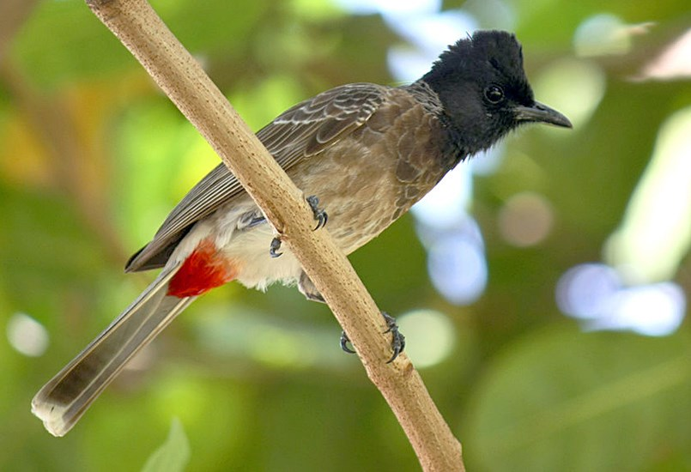
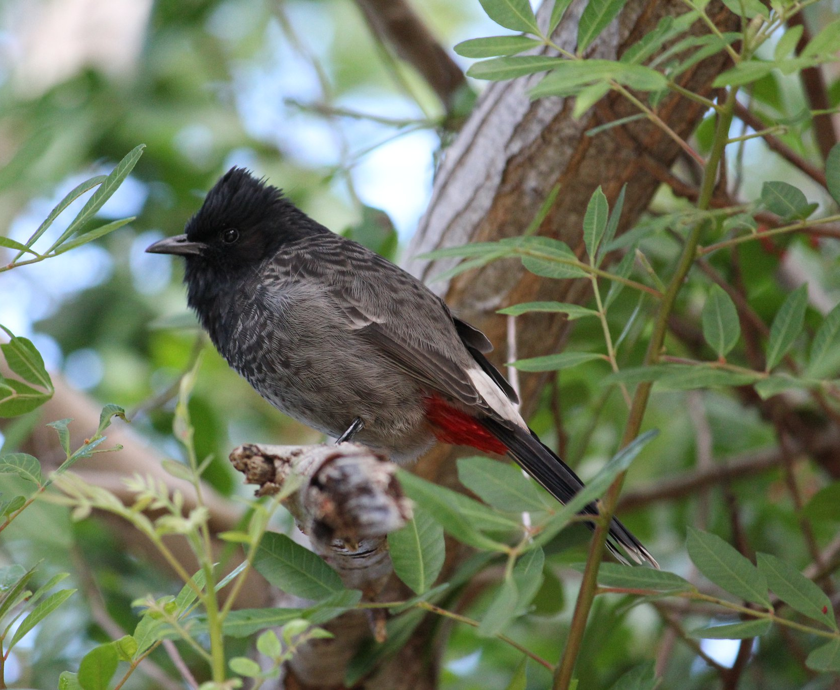
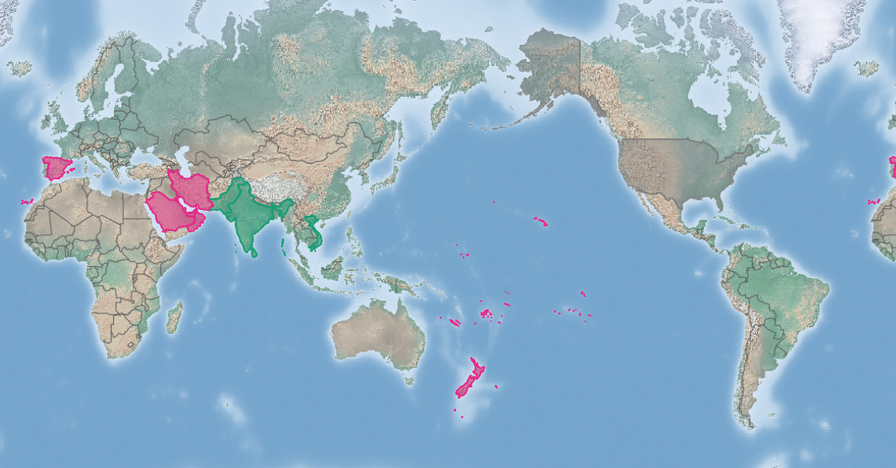
Red-vented bulbul
Pycnonotus cafer
KEY FEATURES
Around 21 cm long with a mass of 26-45 g
The head is dark and crested (with feathers sticking up) with a white belly and bottom but crimson under the tail coverts (coverts are feathers that cover other feathers)
The young is much like the adult except there is some brownish edging on the feathers
The male and female look similar, although the male tends to be slightly larger
The Red-vented bulbul is a quick flyer with a flight that is recognisable by being somewhat bouncy rather than even
Red-vented bulbuls live around secondary growth and shrub, cultivated areas, parks and gardens and are found in forest and agricultural areas. Rarely found in mature forests
Although the main diet is fruits, berries, it also eats plant buds and flowers, as well as insects and small lizards
PATHWAYS ✓ shipping ✓ pet trade
Introduced
Native
Origin not
recorded

Slide 2






Red-vented bulbul
Pycnonotus cafer
IMPACTS
Environment
Health
Society &
Culture
Economy
Not reported, but could compete with native species that have a similar diet or nesting needs
Not reported
Not reported
The birds destroy fruits, flowers, beans, tomatoes, peas and ripe soft fruit like bananas. They might also help spread of seeds of invasive plants like Lantana camara and Miconia calvescens
DISTRIBUTION
Native range The eight Red-vented bulbul sub-species are variously found across India, Sri Lanka, Pakistan, Thailand, Myanmar, Nepal, Bangladesh, south-western China and Vietnam
Introduced range Bahrain, Iran, Kuwait, Oman, Qatar, Saudi Arabia, United Arab Emirates, Spain, Hawai’i, parts of the United States, Fiji, Tonga, American Samoa, New Caledonia, New Zealand, Marshall Islands, Samoa, French Polynesia, Australia (eradicated)
ADDITIONAL NOTES
There are eight sub-species of Red-vented bulbul, and some can hybridise (cross-breed)
INFORMATION SOURCES (click links for more)
Images © Anton Croos-2011 via wikipedia and CABI - CC BY-SA 3.0 (top) © Dianne Parker via https://www.nzbirdsonline.org.nz/species/red-vented-bulbul (bottom)
Text Wikipedia: https://en.wikipedia.org/wiki/Red-vented_bulbul
Text and map Pycnonotus cafer (red-vented bulbul) – CABI https://www.cabi.org/isc/datasheet/45977

