Slide 1
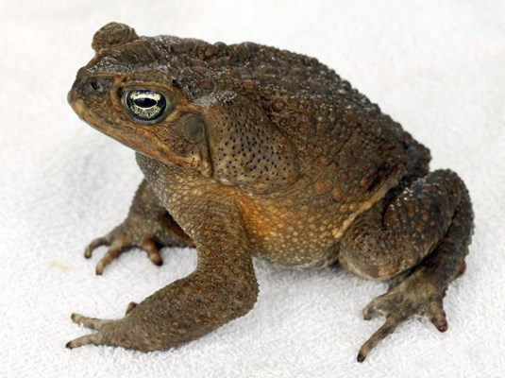
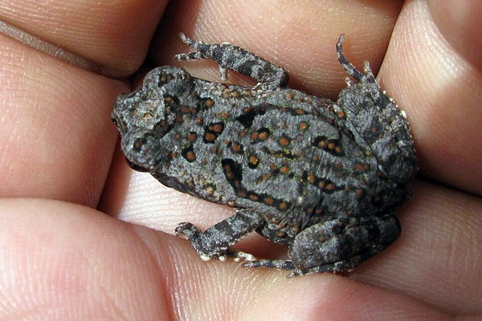
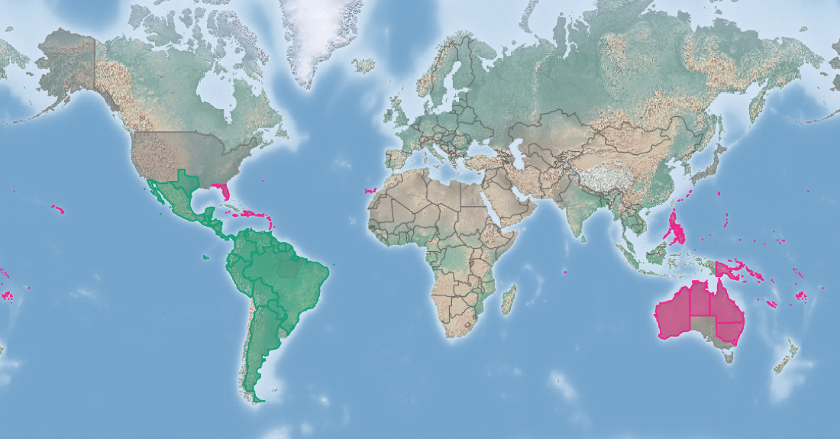
Cane toad
Rhinella marina
KEY FEATURES
Adults have a rough, warty skin, coloured tan, brown or dark brown, dull green or black
Can grow up to 30cm long, with an average of 12-15cm in many regions. Males slightly smaller
Fingers lack webbing, but toes are heavily webbed
The tympanum is distinct, about one half to two thirds the size of the eye
Venom glands clustered together to form large and distinctive parotoid glands, found above each shoulder (top image). These glands can ooze venom
Original habitat was seasonal Amazonian savanna, with small fresh water lakes. Also found in rain forests in their native range and introduced range, though not at high densities
Able to use human-altered environments such as artificial ponds, gardens, drain pipes, debris, under cement piles and under houses
Cane toads will usually stay on dry land and reproduce in any shallow water nearby. Adults, tadpoles and young frogs (bottom image) are tolerant of very high levels of salinity
PATHWAYS ✓ shipping ✓ biological control ✓ water
Introduced
Native
Origin not
recorded

Slide 2






Cane toad
Rhinella marina
IMPACTS
Environment
Health
Society &
Culture
Economy
Cane toads will feed on almost any terrestrial animal and compete with native amphibians for food and breeding habitats. Their toxic secretions can cause illness and death in wildlife, such as snakes and lizards
Toxic secretion causes extreme pain if rubbed into the eyes. Human deaths have been recorded after ingestion of the eggs or adults.
Have been observed entering water tanks in Tuvalu, which could contaminate supply
Not reported
Reported as having a positive impacts as a biological control. However, as they will eat anything they likely also have a negative impact on biological control insects
DISTRIBUTION
Native range Northern South America (Argentina, Bolivia, Brazil, Ecuador, Colombia, Paraguay, Venezuela, the Guianas, Peru, Trinidad and Tobago), Central America, and Mexico northward to extreme southern Texas
Introduced range Hawai’i, Puerto Rico, US Virgin Islands, Guam, Northern Mariana Islands, American Samoa, Palau, Papua New Guinea, Philippines, Cook Islands, Micronesia, Fiji, Kiribati, Republic of the Marshall Islands, Solomon Islands, Tuvalu, much of the Caribbean, Australia, Japan, Egypt, Mauritius and Diego Garcia of the Chagos Archipelago
ADDITIONAL NOTES
Cane toads were introduced to many countries as biological control agents for insect pests of sugarcane and other crops.
INFORMATION SOURCES (click links for more)
Images © David McClenaghan/CSIRO/Bugwood.org - CC BY-NC 3.0 US (top) © Taran Rampersad/KnowProSE/Bugwood.org - CC BY-NC 3.0 US (bottom)
Text, images Rhinella marina (cane toad) – CABI and map https://www.cabi.org/isc/datasheet/10333

