Slide 1
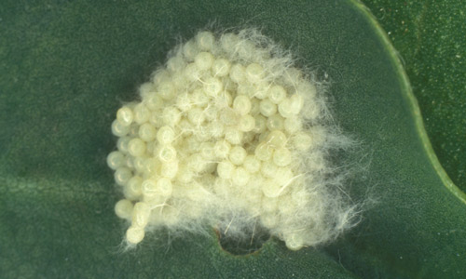
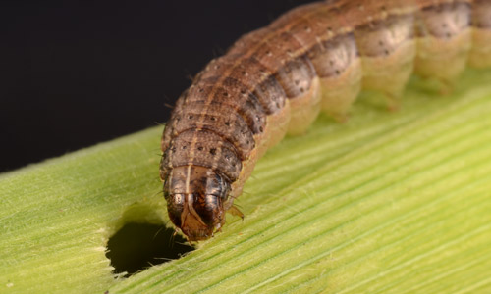
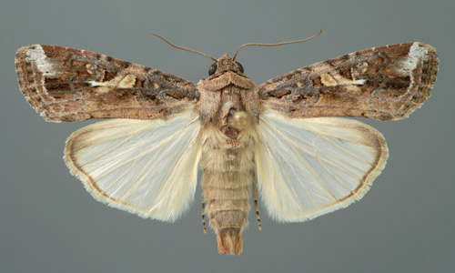
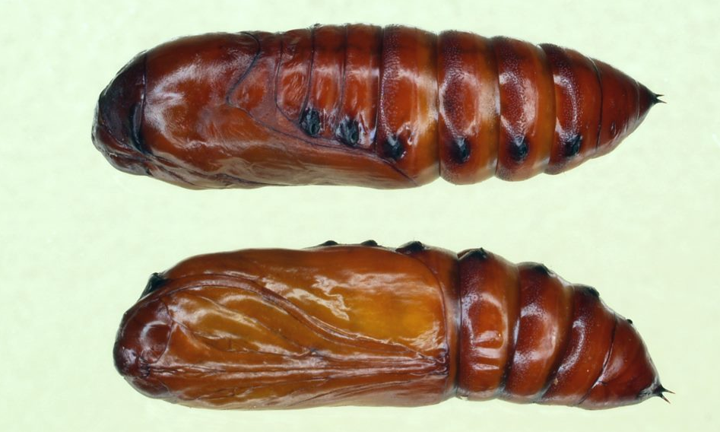
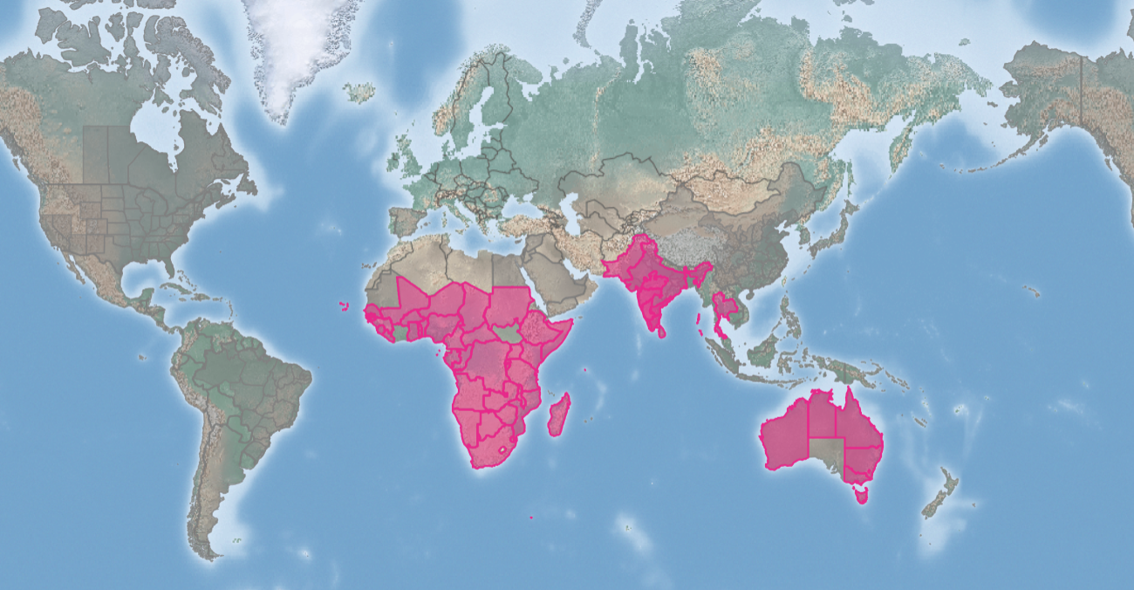
Fall Armyworm (FAW)
Spodoptera frugiperda
KEY FEATURES
Fall armyworm (FAW) is a major agricultural pest that can cause significant damage to crops
Feeds on a wide variety of crops, including maize, rice, sugarcane, and vegetables
Adult is a strong flier and can disperse long distances (up to 100km/night)
Has four distinct life stages: egg, larva, pupa, and adult, as shown on the left (clockwise from top left)
Can complete its lifecycle in as little as 20 days, depending on the temperature. This allows it to produce multiple generations per year
Females can lay up to 1,000 eggs. Even a small infestation can quickly spiral out of control
The larvae are the most destructive stage of the fall armyworm
Larvae are green or brown with three white stripes along their backs. They have a pale, upside-down Y-shaped marking on their head (see image, top right)
The larvae feed on leaves, stems, and cobs of corn. They can skeletonize leaves or completely defoliate plants
In severe cases, the fall armyworm can destroy entire crops
Climate change is making it easier for FAW to survive and spread. The pest is now able to overwinter in areas that were previously too cold
PATHWAYS ✓ shipping containers ✓ windborne dispersal
Introduced
Native
Origin not
recorded

Slide 2






Fall Armyworm (FAW)
Spodoptera frugiperda
IMPACTS
Environment
Health
Society &
Culture
Economy
The FAW can disrupt pollination of a wide range of plants
The FAW can indirectly spread diseases by carrying and transmitting viruses and parasites to other insects
Crop losses can lead to food insecurity, especially in developing countries, which can lead to a range of health impacts
No direct impacts reported but likely flow-on impacts from damage to plants and environment
Crop losses can be as high as 40%. In Africa FAW has cost the continent an estimated $9.4 billion in economic losses, affected food security of 30 million people. In 2019, FAW caused an estimated $3.6 billion in crop losses in Asia
DISTRIBUTION
Native range The pest is native to the Americas, from the southern United States to Argentina
Introduced range It was first detected in Africa in 2016 and has since spread to over 70 countries, including many in the Asia, Oceania, and Europe regions.
ADDITIONAL NOTES
There are other look-alike species that can be confused with the fall armyworm. These include the yellow-striped armyworm (Spodoptera ornithogalli), the southern armyworm (Spodoptera eridania), the variable armyworm (Spodoptera exempta), and the corn earworm (Helicoverpa zea)
The FAW is a very adaptable insect and can survive in a wide range of climates. This makes it difficult to control and is likely to continue to spread to new areas
INFORMATION SOURCES (click links for more)
Images © James Castner (top left), © Lyle J. Buss (top right, bottom left), all University of Florida
© Jim Kalisch, University of Nebraska-Lincoln (bottom right)
Text and map CABI. (2023). Fall armyworm. CABI Compendium: Crop Protection. https://doi.org/10.1079/cabicompendium.29810
Ministry for Primary Industries. (2023). Fall armyworm. Biosecurity New Zealand. https://www.mpi.govt.nz/biosecurity/major-pest-and-disease-threats/fall-armyworm/

