Slide 1
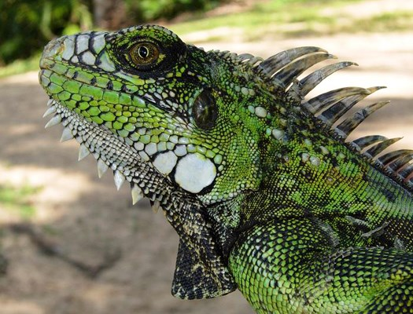
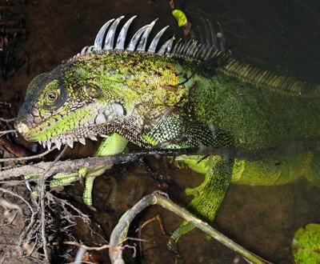
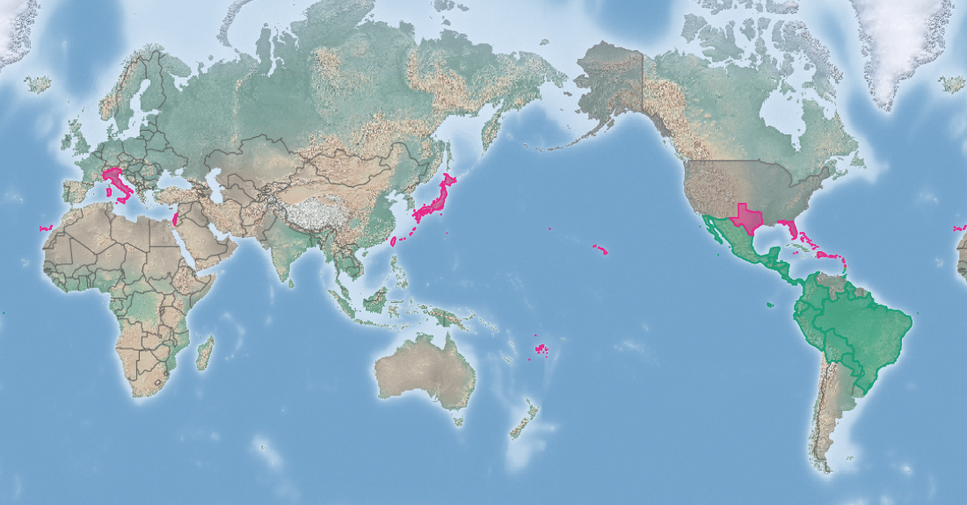
Giant invasive iguana (GII)
Iguana iguana
KEY FEATURES
Giant invasive iguana (GII) is a large lizard that can reach 2 m in length and weigh over 5 kg, but is typically 0.4-2.15 kg. The tail is 2.5-3 times the length of the body. Toes are long, with long curved claws for climbing. There is a large dewlap (fold) of skin, with spines along its edge, under the chin, and a row of flexible spines running from the neck down the back and onto the first part of the tail
Most are mainly green in colour. However, some can be have black, grey, white, bluish, green or brown. Colour can be overlaid with patterns: darker spots, blotches or bands. Dark bands on the tail are common.
Males are larger than females and have larger dewlaps and jowls. Young are typically a vivid green colour either with or without darker streaks or marbled bands, and with smaller spines
Giant invasive iguana can reach very high densities for such a large lizard, laying clutches of 14-77 eggs
Can use a range of tropical and sub-tropical, dry and semi-dry habitats, including urban areas
Eat a wide variety of plant foods
Adult females can travel up to 3 km between nesting areas and their normal home range
An excellent swimmer in fresh and saltwater, it can remain submerged for over 4 hours and has likely colonized neighbouring islands by swimming
PATHWAYS ✓ shipping ✓ pet trade ✓ swimming (local)
Introduced
Native
Origin not
recorded

Slide 2






Giant invasive iguana (GII)
Iguana iguana
IMPACTS
Environment
Health
Society &
Culture
Economy
Most impacts are on other iguana species. Can also carry wildlife diseases and ticks that can harm other reptiles. Eat and destroy native plants. Can disperse seeds of invasive plants
Can transmit Salmonella (a bacterium that causes food poisoning). Large lizards can cause severe bites and painful blows with their whip-like tails
None reported
Destroy cultivated plants. Can cause erosion and road collapse by burrowing
DISTRIBUTION
Native range from Mexico south to Paraguay and south-eastern Brazil. Numerous islands, including Cozumel, San Andrés and Providencia, Roatán, Utila, Cayo Icacos, Trinidad and Tobago, Grenada,Saint Vincent and the Grenadines, Saint Lucia, Montserrat and Saba
Introduced range United States (Florida, Hawai’i (Oahu and Maui) and Texas), Japan (Ishigaki Island), Fiji (Qamea, Matagi, Laucala, Taveuni and Koro Islands), the Canary Islands, Israel, and many islands in the West Indies
ADDITIONAL NOTES
INFORMATION SOURCES (click links for more)
Images © ©Elizabeth A. Rosnik via CABI
Text, images Iguana iguana (iguana) – CABI https://www.cabi.org/isc/datasheet/28477 and map

