Slide 1
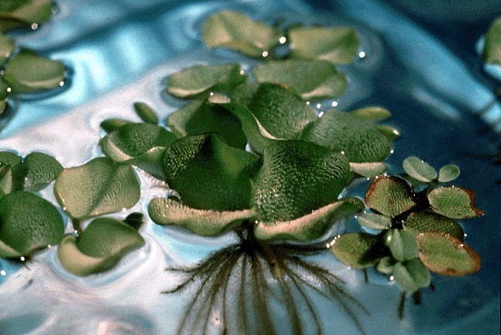
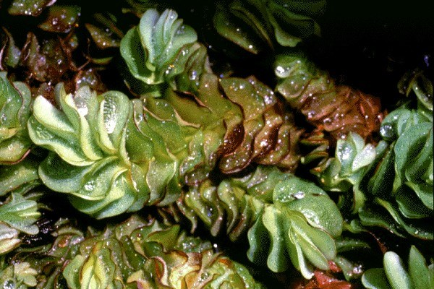
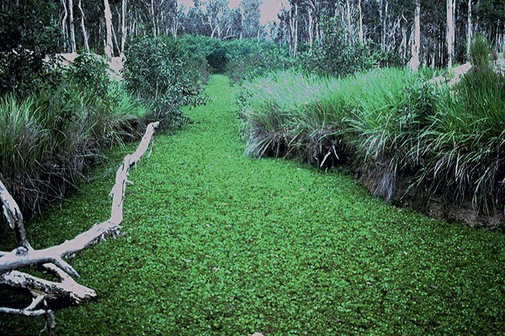
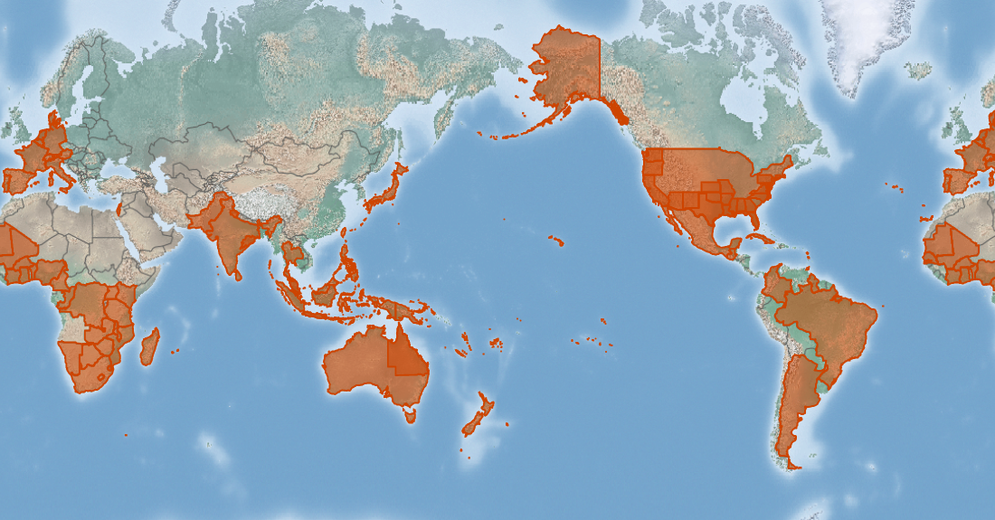
Kariba weed
Salvinia molesta
KEY FEATURES
Kariba weed is a free-floating plant (a fern) that dominates a wide variety of water habitats in its introduced range, including lakes, rivers and rice paddies flood canals, artificial lakes and hydro-electric facilities swamps, drainage channels and along river margins
Prefers stagnant or slow moving water, often in small bays and inlets of dissected shorelines and tributaries of small streams, where it is protected from wave action
Plants produce green vegetation on hairy stems that reach up to 30 cm long and 5 cm wide.
Forms mats 2.5 cm thick (or much thicker, depending on local conditions such as water current, waves, and so on)
Spread within an system by movement of plants by wind, water currents, floods and animals. Birds and animals that use waterways can spread the weed between waterways. Spread between waterways is assumed to be mainly by people moving plants intentionally (as ornamentals), unintentionally as a hitchhiker on boats, or in shipments of aquatic plants and fish
Increased transport of commodities in international commerce will increase the movement of Kariba weed around the world
PATHWAYS ✓ water ✓ pet and aquarium trade
Present (status not recorded)

Slide 2



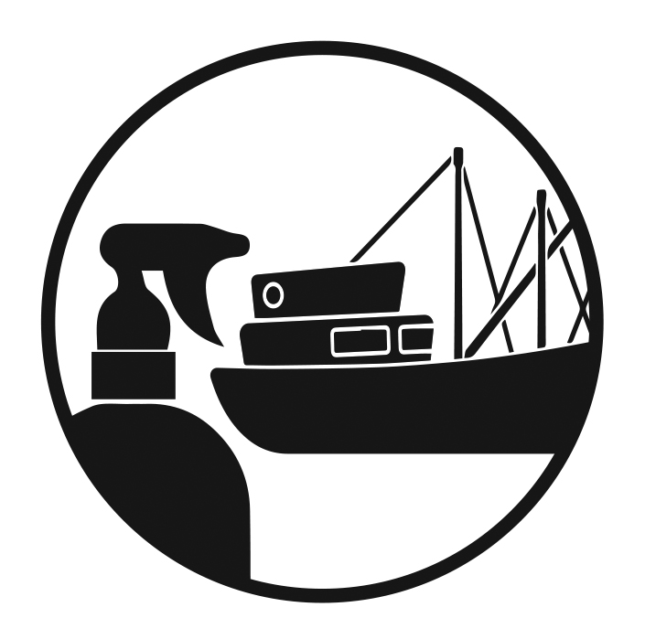


Kariba weed
Salvinia molesta
IMPACTS
Environment
Health
Society &
Culture
Economy
Disrupts native ecosystems, reducing natural resilience. Thick mats cut off light and outcompete native plants, and impacts water quality, affecting native plant and fish populations
Dense mats host mosquitoes and snails that can pass on human diseases. Mats prevent the passage of boats and canoes impede transport by water and block access to drinking water by people, domestic stock and wildlife
Communities that rely on boat transport may be affected by clogging of waterways, limiting access to schools, healthcare and supplies
Major problem in lowland rice paddies. Drowning of livestock that try to walk on the dense mats. Impacts commercial and recreational fishing by preventing boat access and clog irrigation and drainage canals
DISTRIBUTION
Native range South-eastern Brazil
Introduced range widespread throughout the world in a variety of freshwater habitats
ADDITIONAL NOTES
Based on the environmental, economic and human health impacts ranks a close second behind water hyacinth on a list of the world's most noxious aquatic weeds
INFORMATION SOURCES (click links for more)
Images (top to bottom) © Colin Wilson (2 images), © Bill Parsons, all via CABI
Text and map Salvinia molesta (Kariba weed) – CABI https://www.cabi.org/isc/datasheet/48447

