Slide 1
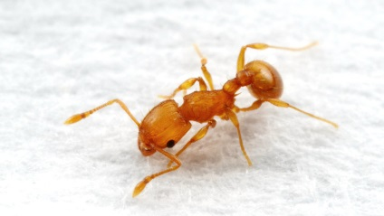
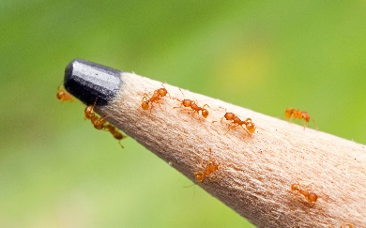
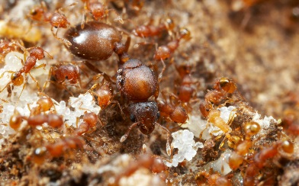
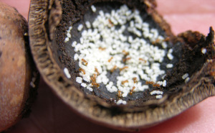
These ants will cause harm to you, your crops and your environment. If you find any of these ants, contact your local biosecurity/quarantine
LITTLE FIRE ANT
STOP THIS INVADER
IN THE PACIFIC
Wasmannia auropunctata
Size: 1.5mm
stings
harms
crops
harms
people
harms
wildlife
lives on
ground
lives in trees
day
active
© www.alexanderwild.com
What they look like
tiny, look like moving dots
light orange body
slow moving
workers (the ants you see) fall from trees like “stinging rain”
workers 1.5 mm long
Queens (live in nests) are much larger than workers
Problems they cause
kill small animals like crabs, birds &lizards
painful sting that causes an itchy rash
can blind domestic animals
can affect people’s vision if stung in the eye (clouded cornea)
make it difficult to farm (stinging)
in high densities they make land uninhabitable
Where they live
build nests in and around places like
cracks in buildings
bedding and furniture
rocks, leaves and twigs
trees (including high branches) and shrubs
decaying nuts (e.g. macadamia, coconut)
How they travel
hidden in
fruit and other food
plants
soil, mulch and compost
luggage
decaying nuts (e.g. macadamia, coconut)
© www.alexanderwild.com
© www.alexanderwild.com
© www.alexanderwild.com
© Panya Kuanun/Shutterstock
© Hawai’I Department of Agriculture
Notes:
Example: This is a version of the Little fire ant poster intended to be printed A4 size.

