Slide 1
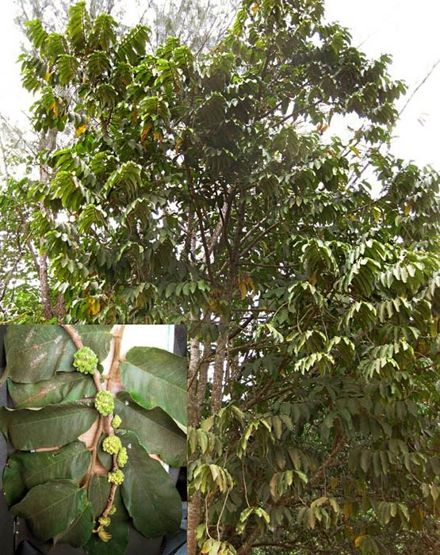
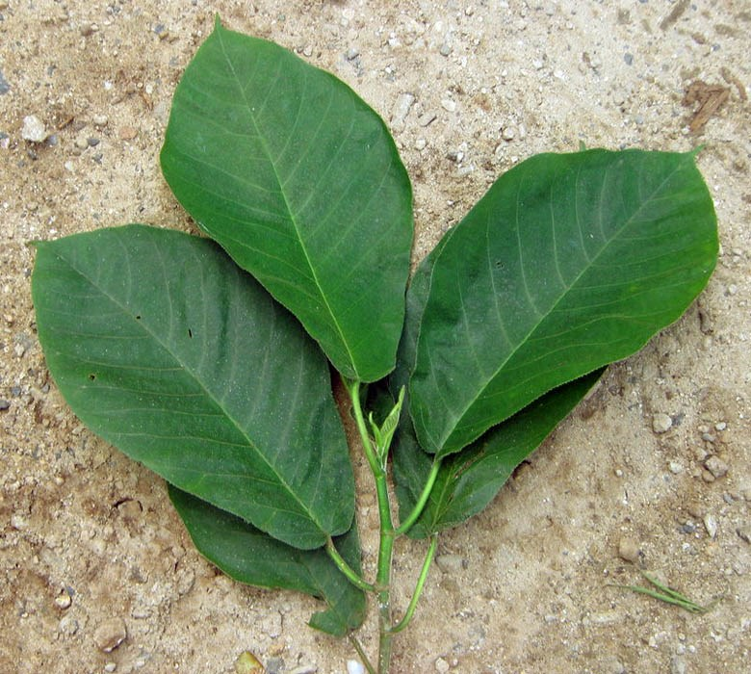
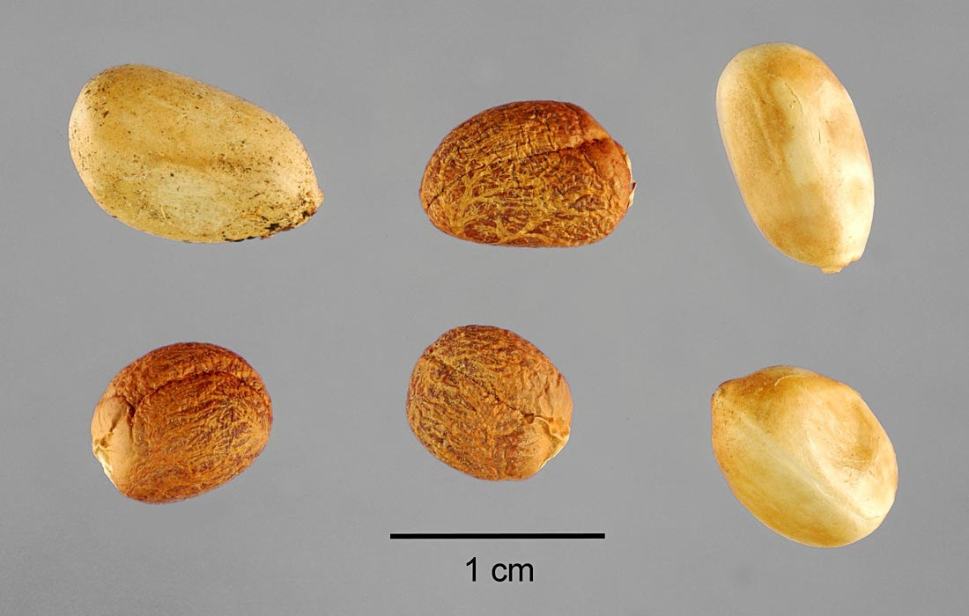
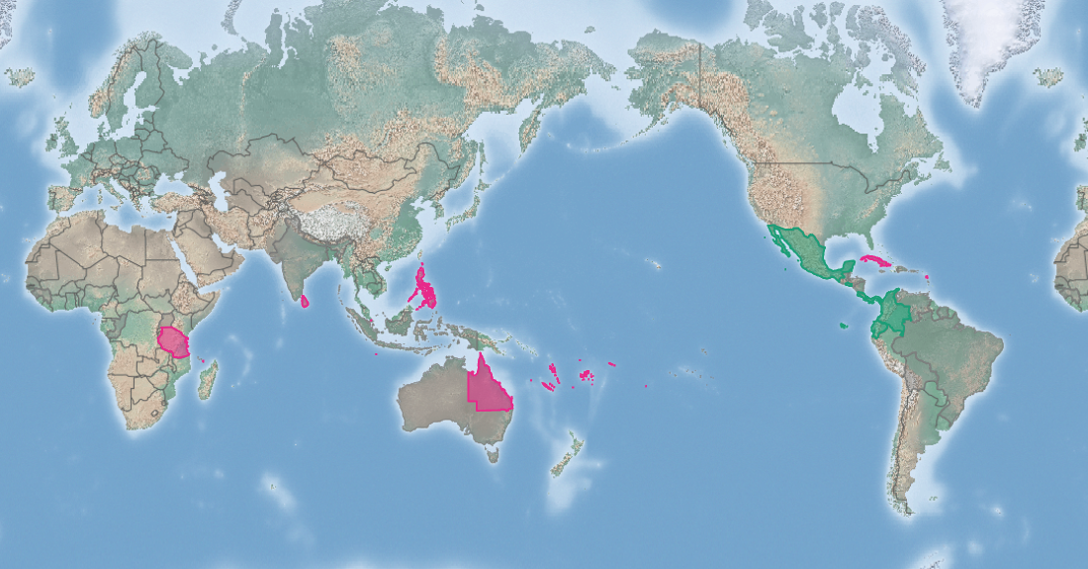
Mexican rubber tree
Castilla elastica
KEY FEATURES
Mexican rubber tree is invasive in Samoa, American Samoa, French Polynesia and Vanuatu in the Pacific where it poses significant threats to native forest ecosystems
The tree can grow up to 30 m tall with a diameter at breast height of up to 60 cm. The plant produces abundant milky sap when cut. It has spreading or drooping branches, the young ones woolly-hairy.
The leaves are coarse, densely hairy on both sides, short-stemmed, arranged in two rows. The leaf is oblong, broadest in the upper half, 20-45 cm by 7-15 cm. The base of the leaf is heart-shaped and the tip pointed
Small, female flowers in clusters of 2-4 develop into fruit about 4 cm in diameter, consisting of a cluster of many red individuals about 2 cm long, with sweet, edible pulp
Seeds are eaten and dispersed by birds and other animals, contributing to spread
PATHWAYS ✓ garden and forest escapes ✓ forestry
Introduced
Native
Origin not
recorded

Slide 2






Mexican rubber tree
Castilla elastica
IMPACTS
Environment
Health
Society &
Culture
Economy
Potential to displace slow growing native species which are sensitive to competition. Likely to decrease ecological stability on slopes
None reported
Reduced aesthetic value of forest, exclusion of trees of value for traditional uses
None reported
DISTRIBUTION
Native range southern Mexico, Central America and parts of South America
Introduced range Tropical Asia, Oceania and Africa, including India, Sri Lanka, Java, West Indies, Singapore, Mauritius, West Africa, Tanzania, Fiji, Samoa, American Samoa, Vanuatu, French Polynesia and Queensland
ADDITIONAL NOTES
The sap was once used to produce latex which was made into rubber
INFORMATION SOURCES (click links for more)
Images (top to bottom, left to right) ©2009 Moorea Biocode/CalPhotos, University of California, Berkeley (2 images) – CC BY-NC-SA 3.0, ©Steve Hurst/USDA-NRCS PLANTS Database all via CABI
Text and map Castilla elastica (Mexican rubber tree) – CABI https://www.cabi.org/isc/datasheet/11498

