Slide 1
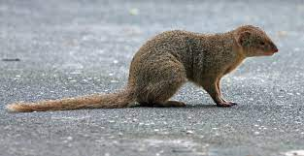
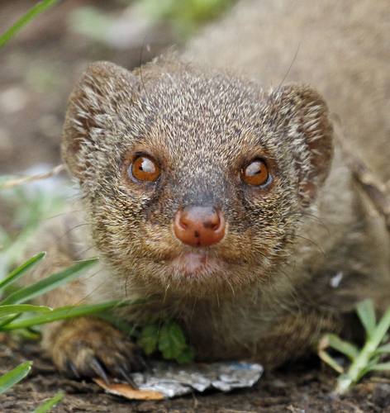
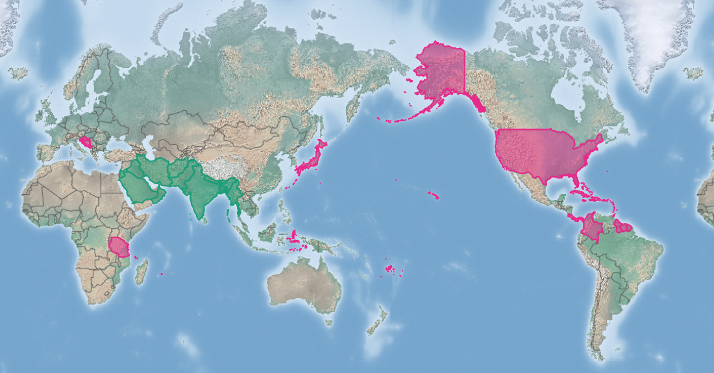
Small Indian mongoose
Herpestes auropunctatus*
KEY FEATURES
Small, slender-bodied with short legs, short, rounded ears and an elongated snout (nose)
The tail is muscular at the base and tapers gradually, ending in tufts of slightly longer fur
Feet have five toes with long sharp non-retractile claws
Fur is soft, pale to dark brown flecked with golden spots. Underside is paler than rest of body
Eyes are amber/brown in adults and blue/green in young animals
Females range in length from 50 to 58 cm. Males range from 54 to 67 cm
Adult body mass ranges from 305 grams to just over 1 kg in large adult males. Mean mass is 434 grams
Males have a wider head and more robust body
Lives 3-4 years, breeds 2-3 times per year
Varied diet, including smaller mammals, birds, turtles, lizards, snakes and frogs, insects and plant material, depending on what is available
Prefers grassland and secondary growth over dense forest, and also found around peoples homes. Reported to prefer dry habitats.
Needs a warm climate, so distribution could increase with climate change
PATHWAYS ✓ shipping containers ✓ biological control
Introduced
Native
Origin not
recorded

Slide 2






Small Indian mongoose
Herpestes auropunctatus*
IMPACTS
Environment
Health
Society &
Culture
Economy
Eats many native plants and animals, resulting in population declines. Has probably or certainly caused extinction of at least three species and for many other local extinctions
Can be infected with rabies and pass this disease to people (and to other animals), but transmission may be low.
On Okinawa mongoose have been found to be infected with Leptospira and antibiotic-resistant strains of Escherichia coli bacteria
Not reported, but impacts on native animals will have flow-on cultural impacts if these species are of cultural importance
Not reported, but as it will eat small animals and eggs of birds, it could affect poultry industries and other small animal farming
DISTRIBUTION
Native range Saudi Arabia, Iran, Iraq, Afghanistan, Pakistan, India, Nepal, Bangladesh, Myanmar
Introduced range Antigua, Barbados, British Virgin Islands, Bosnia-Hercegovina, United States Virgin Islands, Croatia, Cuba, Fiji (Viti Levu and Vanua Levu), French Guiana, Grenada, Guadeloupe, Guyana, Hawai’i (Hawai‘i, Maui, Moloka‘i, Kauai and O‘ahu), Hispaniola, Jamaica, Japan (Okinawa, Amami, Kyushu), Tanzania, Martinique, Montenegro, Nevis, Puerto Rico, St. Kitts, St. Lucia, St. Martin, St. Vincent, Suriname, Trinidad
ADDITIONAL NOTES
* Herpestes fuscus and other related mongoose species are also invasive. Introduced to several locations as a biological control of snakes and rodents. Also called Mangusta auropunctata, Mangusta pallipes, Herpestes palustris, Herpestes auropunctatus
INFORMATION SOURCES (click links for more)
Images © JN Stuart – some rights reserved (CC BY-NC-ND) (top) © Robin Gwen Agarwal – some rights reserved (CC BY-NC) (bottom)
Text and map Herpestes auropunctatus (small Indian mongoose) – CABI https://www.cabi.org/isc/datasheet/80508

