Slide 1
[country] National Invasive Species Strategy and Action Plan (NISSAP) consultation

Slide 2
Agenda for the consultation
Time | Agenda Item
09.00 | Welcome and prayer
09.20 | Introductions
09.30 | Introduction to Mentimeter
09.45 | Why does [country] need a National Invasive Species Strategy and Action Plan (NISSAP)?
10.00 | BREAK
10.15 | Invasive species causing problems in [country]
10.45 | Prevention of invasive species
11.00 | BREAK
11.10 | The draft Action Plan
12.10 | LUNCH
13.10 | The draft Action Plan (continued)
14.10 | BREAK
14.20 | The draft Action Plan (continued)
14:50 | Next steps and closing

Slide 3
Introduction to Mentimeter
Mentimeter is a way for people to share views and ideas online, anonymously and quickly
We will use Mentimeter to record your comments and feedback
You can use your phone, tablet or computer
If some people don’t have one you can share devices so everyone can answer

Slide 4
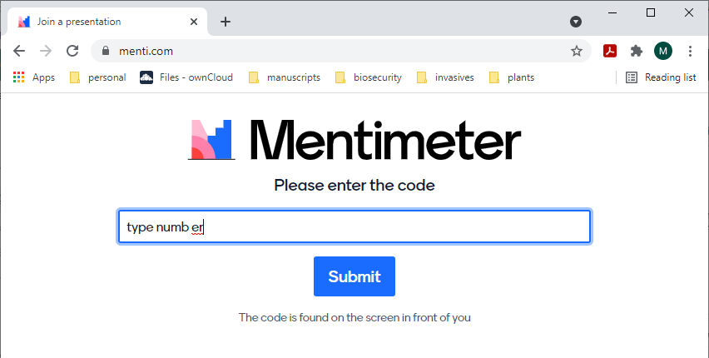
How to use Mentimeter
On your phone or tablet or laptop, open your internet browser and type in the address bar: www.menti.com
Type in the number code shown at the top of this screen

Slide 5
Mentimeter questions
What is your name?
Which village do you come from?
Can you understand what we are saying – are we speaking clearly enough?

Slide 6
Why are invasive species a problem?
Invasive species can harm human health and limit cultural activities
Invasive species cause economic impacts by reducing agricultural, forestry and fisheries productivity
Invasive species cause economic impacts by damaging infrastructure
Together with habitat destruction and overharvesting, invasive species are one of the greatest threats to biodiversity

Slide 7
What is a National Invasive Species Strategy and Action Plan (NISSAP) and why does [country] need one?
A NISSAP is a country-endorsed strategy and set of actions to prevent and manage invasive species
Having a plan is important because:
1. Invasive species are a threat to resources. Invasive species cause harm to the environment, culture, health, economy and agriculture. A NISSAP can highlight the issues for national and international decision makers
2. A NISSAP prioritises invasive species issues. There are more invasive species than a country can deal with all at once. A NISSAP brings people together to agree on the priorities
3. Creating a NISSAP brings all stakeholders together. Managing invasive species involves many organisations and groups. The NISSAP brings all stakeholders together around an agreed plan of priority actions
4. A NISSAP supports a coordinated approach. Managing invasive species involves many activities. A NISSAP helps plan everyone’s roles
5. A NISSAP can be used to get support. A NISSAP shows funders a priority list of tasks for funding, and that the country has committed to the outcomes

Slide 8
What is this consultation for?
[country] has a NISSAP that was created in [year] and expired [year]
Today’s consultation is to make sure the priorities and actions agreed in [year] are still important, and to identify any new priorities and actions
Participant views will be incorporated into an updated NISSAP

Slide 9
Invasive species that can cause problems in [country]
[country] has around [number] invasive or potentially invasive species (mostly plants)
Destructive invasive plants contribute to soil erosion, smother crops and native plants, reduce water resources
Rats, birds, pigs and ants and other insects damage crops, reduce flowering
Rats contaminate water and food, transmitting human and animal disease
Ants and other insects damage plants and carry plant diseases
Rats and cats kill native birds (particularly seabirds), reducing nutrient input into the soils
Domestic animals that are uncontrolled (such as pigs, goats, cats) could harm threatened species such as turtles by degrading habitat and predation
Domestic dogs that are uncontrolled can injure and kill people

Slide 10
Mentimeter questions
What invasive species in [country] are you concerned about?

Slide 11
What are some of the invasive species not yet in [country] that can cause problems?
These invasive species cause very harmful impacts and are a priority for the Pacific Islands region
Snakes
Other reptiles and amphibians
Invasive plants
Invasive birds
Mongoose
Wasps
Fire Ants
Giant African Snail
These species are high priorities for prevention as they are not yet in Niue, or there are new species (like plants and birds) that could arrive

Slide 12
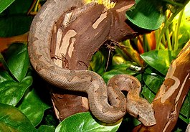
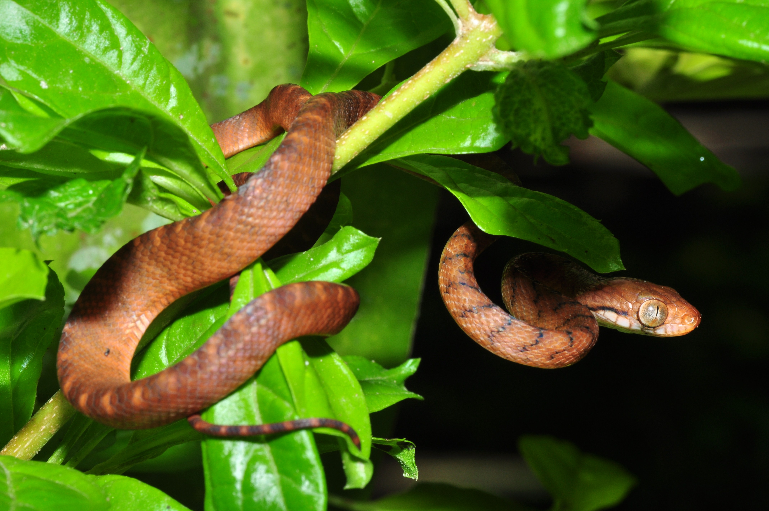
Harm caused by snakes
Snakes eat many types of animals including lizards and birds and their eggs (including forest birds and poultry)
Snakes can kill native animals and cause extinctions
If Brown Tree Snakes or other snakes arrived in [country] they would increase in numbers quickly and could wipe out birds, native reptiles, domestic chickens and other animals
Brown tree snakes have never been eradicated (removed completely from a country), so preventing their arrival is very important
Brown Tree Snake

Slide 13
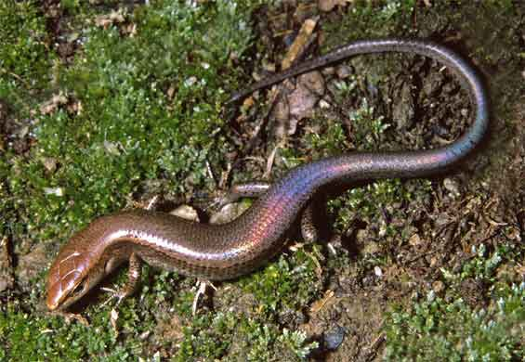
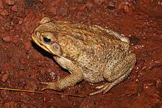
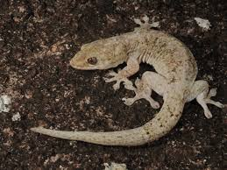
Harm caused by other reptiles and amphibians
Invasive reptiles and amphibians eat native insects, reducing food for native species and for chickens
Invasive reptiles and amphibians compete with native animals for food and other resources
Invasive reptiles and amphibians are food for other invasive species like rats, so increase their impacts
Cane toads and some other reptiles and amphibians can be poisonous to other animals
Plague Skink
Cane Toad
Asian House Gecko

Slide 14
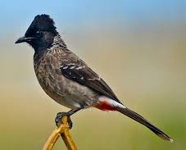
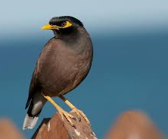
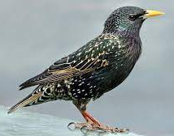
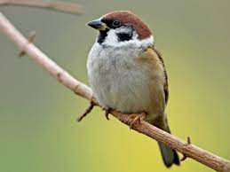
Harm caused by invasive birds
Myna , Red-vented Bulbul and sparrows damage garden and crop fruits including Papaya, Mango and Banana
Pet birds that escape, such as parrots, could bring bird diseases that could harm native birds and chickens
Common Myna and Red-vented Bulbul are aggressive towards other small birds so could harm small native birds
Red-vented Bulbul
Common Myna
Starling
Sparrow

Slide 15
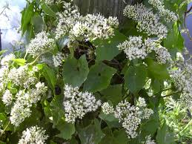
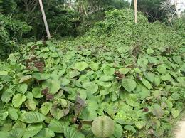
Harm caused by invasive plants
Invasive plants can reduce groundwater supplies by taking up more water than native plants
Invasive plants compete with native plants and make it difficult for them to grow
Invasive plants smother crops so reduce food supplies and result in costs and effort to control them
Invasive plants are fast-growing so more likely to fall in storms and cause hazards and erosion
Mikania
Merremia
Both plants are found in [country] but there are others that could arrive

Slide 16
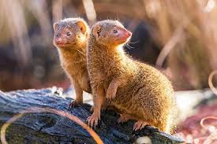
Harm caused by Mongoose
Mongoose breed quickly, eat a variety of fruits and animals, and are difficult to get rid of
Mongoose can kill native birds and reptiles. Many species in Hawai’i and Fiji are almost extinct (killed off completely) due to mongoose
Mongoose can easily “stowaway” on ships and have been accidentally introduced to many Pacific countries from Fiji and Hawai’i
If they arrived in [country], Mongoose could kill many birds, including chickens, and affect turtle breeding
Mongoose

Slide 17
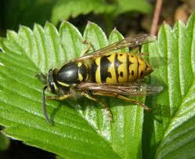
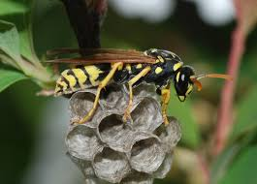
Harm caused by wasps
Wasps have painful stings
Wasps can attack in ‘swarms’ and the stings can kill people
Wasps can make it difficult to spend time outside
Wasps eat almost any small animal, including bees, other insects, spiders and native birds
Wasps can reduce pollination of crops
Common Wasp
Paper Wasp

Slide 18
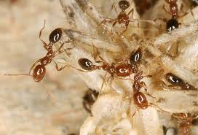
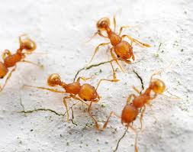
Harm caused by Fire Ants
Fire Ants kill and eat anything that can’t escape – all small animals
Fire Ants sting people – a painful, itchy sting that can get infected
Red Imported Fire Ants can cause fatal allergic reactions
Little Fire Ant stings can blind pets, domestic animals and people
Little Fire Ants can cause outbreaks of insects that damage crops
Little Fire Ants make it difficult to tend crops – the ants fall out of trees and onto people like a “stinging rain”
Red Imported Fire Ants could cause > [$??] per year in crop, health, and infrastructure losses in [country]
© Benoit Guernard
© Alex Wild
Red Imported Fire Ants
Little Fire Ants
Notes:
The $ figures from Fire ant losses are available from https://piat.org.nz/uploads/PIAT_content/docs/Gruber%20et%20al.%202021.%20EMR%20pre-publish.docx

Slide 19
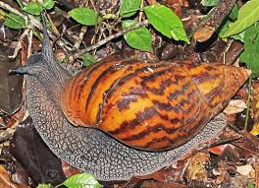
Harm caused by Giant African Snails
Giant African Snail can damage more than 500 types of plants, including native plants and crops like breadfruit, cassava, cocoa, papaya
Rat lungworm infects the Giant African Snail. If the snails are eaten by people the lungworm can cause a sometimes fatal brain inflammation
Giant African Snail has fast population growth and death - flies and mosquitoes can breed in dead bodies or empty snail shells
Giant African Snail competes with native land snails
Giant African Snail are easily moved in soil and potted plants and hard to control or remove completely
Giant African Snail

Slide 20
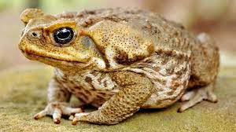
Mentimeter questions
Have you heard about these animals and plants before today?

Slide 21
Mentimeter questions
Do you have any questions or comments about these groups of animals and plants?

Slide 22
Mentimeter questions
What do you think needs to be done to prevent arrival of invasive species in RMI?
Can choose more than one
More community awareness about the problems invasive species cause
Find them as soon as they arrive and get rid of them
Better biosecurity on ships that come to RMI
Better quarantine (biosecurity) at the airport and ports
Stronger fines if people bring them in
Stronger restrictions on trade with countries that have these plants and animals
Nothing else – I’m not worried about these species

Slide 23
The draft Action Plan
FOUNDATIONS
A1 - Generating support
A2 - Building capacity
A3 - Legislation, policy, and protocols
PROBLEM DEFINITION, PRIORITIZATION AND DECISION-MAKING
B1 - Baseline & Monitoring
B2 - Prioritization
B3 - Research on priorities
MANAGEMENT ACTION
C1 - Biosecurity
C2 - Management of established invasives
C3 - Restoration

Slide 24
A1: Generating support – to ensure people understand the problems invasive species cause
Awareness and outreach programmes
Government support for invasive species is enhanced
Invasive species included in school curriculum (primary/secondary)
Awareness of marine invasive species

Slide 25
Mentimeter questions
Do you agree with these Actions?
Is there anything else needed to generate support?

Slide 26
A2: Building capacity – [country] has the skills, resources and infrastructure to prevent and manage invasive species
A National Invasive Species Co-Ordinator is needed
A Technical Advisory Group with members from government departments (TAG)
Take part in regional meetings to share knowledge
More biosecurity training
Work programmes are implemented
Funding is available to carry out NISSAP actions

Slide 27
Mentimeter questions
Do you agree with these Actions?
Are more facilities like fumigation, quarantine sheds needed?
Anything else needed to build capacity?

Slide 28
A3: Legislation, policy and protocols – these are needed to effectively prevent and manage invasive species
NISSAP is up-to-date (this review and one in five years)
Operational manual and other policies/procedures for biosecurity

Slide 29
Mentimeter questions
Do you agree with these Actions?
Anything else needed for regulations or policies?

Slide 30
B1: Baseline and monitoring – identifies the status of invasive species and their impacts in RMI
Biodiversity surveys (marine and terrestrial)
Collection and sharing biodiversity information

Slide 31
Mentimeter questions
Do you agree with these Actions?
Anything else needed to help with baselines and monitoring?

Slide 32
B2: Prioritisation – the risk of invasive species is understood so high priority species can be targeted
Risk profiles for the most important invasive species threats completed

Slide 33
Mentimeter questions
Do you agree with these Actions?
Anything else needed to help with prioritisation?

Slide 34
B3: Research on priorities – research helps to identify priorities and improve invasive species management
Use available research to guide prevention and management of priority species

Slide 35
Mentimeter questions
Do you agree with these Actions?
Anything else needed to help with research on priorities?

Slide 36
C1: Biosecurity – to prevent the arrival of new species, the transport of existing species and rapid response if priority species are moved around
Domestic and international pathways secured (biosecurity)
Early detection and rapid response programmes
Marine and terrestrial (including weeds) invasive species surveillance programmes
Biosecurity register and records to incorporate invasive species
Enhanced biosecurity by ship’s Masters
Measures in place to control the spread of invasive species within [country]

Slide 37
Mentimeter questions
Do you agree with these Actions?
Anything else needed to help with biosecurity?

Slide 38
C2: Management of established invasives – harm caused by invasive species is reduced by controlling or removing them completely
Continue focus on feral pigs
Carry out local feral cat control
Control numbers of feral dogs
Crown of thorns control
Rat eradications
Weed control using herbicides
Weed control using biological control

Slide 39
Mentimeter questions
Do you agree with these Actions?
Anything else needed to help with management of established invasives?

Slide 40
C3: Restoration – integrated management of a range of invasive species at priority sites for the benefit of communities and ecosystems
Site-led invasive species control
Invasive species control included in management plans for village-based conservation areas

Slide 41
Mentimeter questions
Do you agree with this Action?
Anything else needed to help with restoration?

Slide 42
Next steps for the [country] NISSAP
You can provide more feedback or ask questions through email to National Invasive Species Coordinator [name]
Responses from the consultation will be summarised as an appendix in the draft NISSAP
No personal information will be included in the appendix
Views shared today will be considered along with technical contributions to complete the NISSAP
Sometimes people disagree on what is important and what needs to be done. The NISSAP will represent the majority view, and based on what is possible

Slide 43
Many thanks for taking part in this consultation

