Slide 1
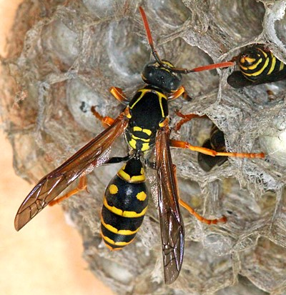
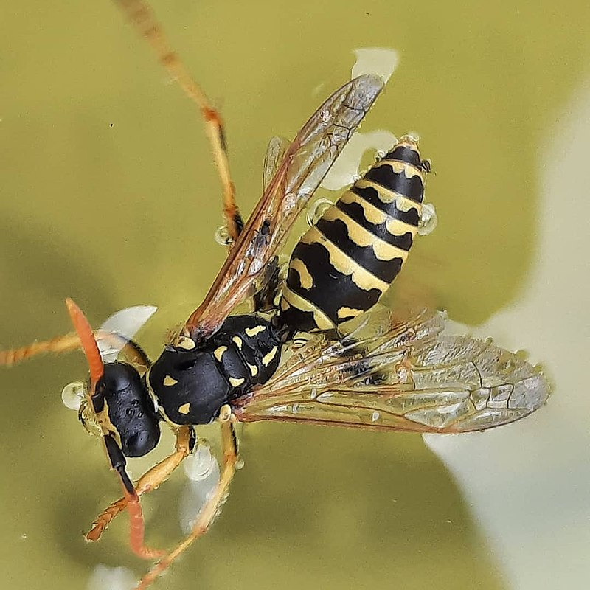
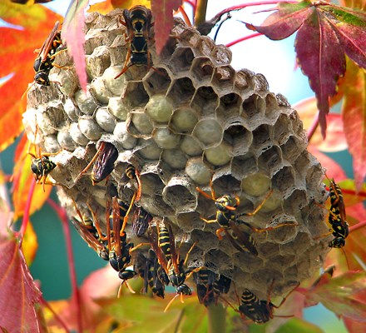
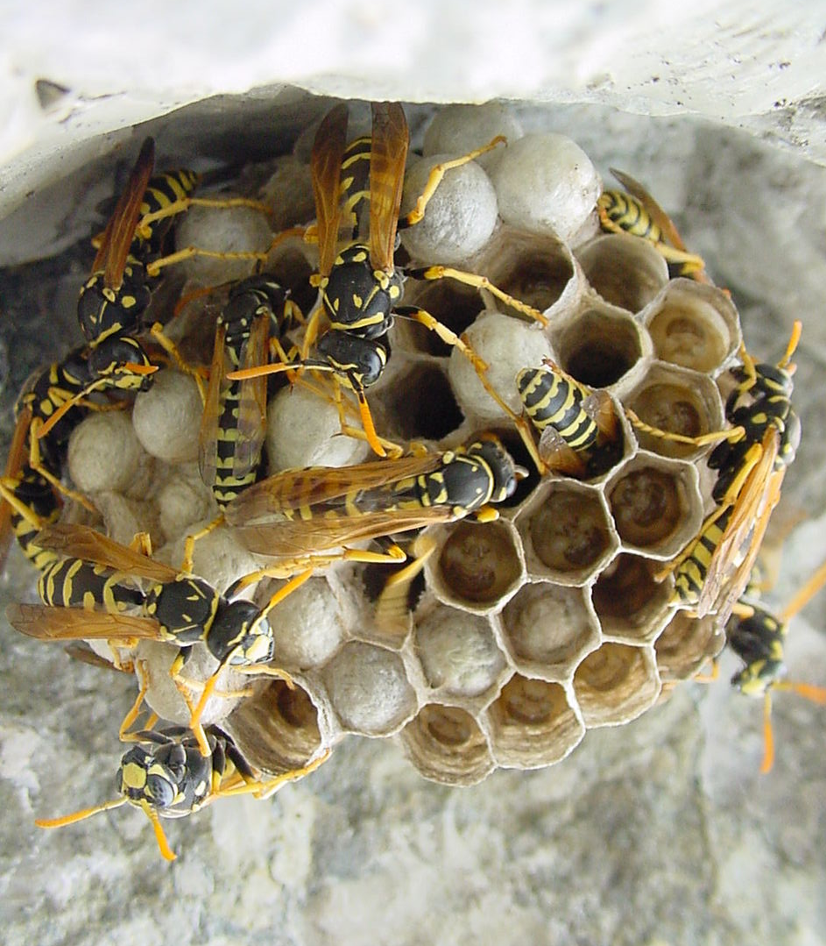
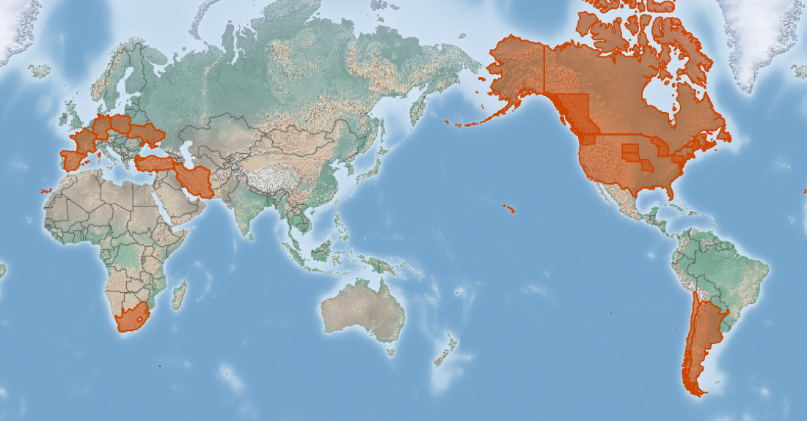
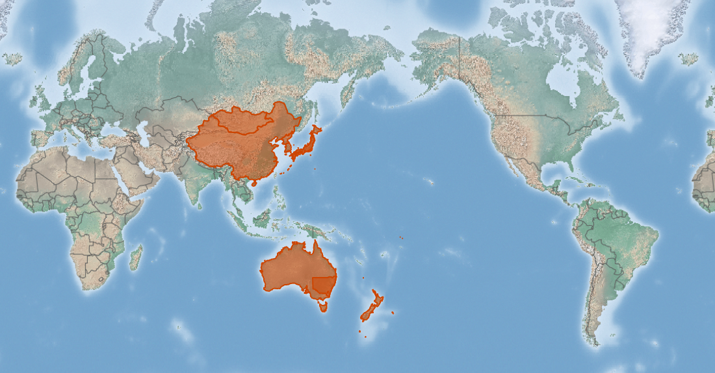
Paper wasps
Polistes spp*
KEY FEATURES
Asian paper wasp European paper wasp
Two species of paper wasps are of concern around the Pacific region
Asian paper wasps have slender 13mm-25mm reddish brown to black bodies with yellow rings and reddish areas on abdomen. Their wings are reddish or amber brown and they have long legs that especially noticeable in flight when they hang down
European paper wasps are a little larger (20-25 mm long), and the body is black and yellow
They live in a wide range of habitats, including woodland, shrubland, grassland and agricultural, urban and suburban areas.
European paper wasps build nests using paper and saliva
The Asian paper wasp frequently constructs its nest on man-made structures such as houses or other buildings , or in trees or bushes, usually on the branches, but sometimes on stems and leaves. Often nests are hidden inside dense shrubs, making them difficult to locate
PATHWAYS ✓ shipping ✓ bulk freight/cargoes
Present

Slide 2






Paper wasps
Polistes spp*
IMPACTS
Environment
Health
Society &
Culture
Economy
The Asia paper wasp eats insects and so competes with other insect eaters. This can have a flow on effect to ecosystem like pollination
Both species can sting people, who can suffer allergic reactions. European paper wasp spreads yeast and fungi that damage fruit and may adversely affect people who work in those environments
The Asian paper wasp is a nuisance, stinging people when it is disturbed and making nests on houses
European paper wasp is a common pest in fruit orchards and spreads yeast and fungi that damage fruit
DISTRIBUTION
Ranges Spain, France, Germany, Poland, Ukraine, Turkey, Iran, China, Mongolia, Japan, Korean peninsula, United States and Canada, Australia, New Zealand, Hawai’i(?), Argentina, Chile, South Africa
ADDITIONAL NOTES
* This factsheet describes two closely related species, the Asian paper wasp (Polistes chinensis), and the European paper wasp (Polistes dominula). They have similar impacts and look similar. As their native and introduced ranges all differ, the entire range of both species is described here
INFORMATION SOURCES (click links for more)
Images Asian paper wasp © Philip Spradbery via CABI, European paper wasp © Garnhami CC BY-SA 4.0 via Wikipedia and © Bramfab CC BY 2.5 via Wikipedia
Text and map Polistes chinensis (Asian paper wasp) – CABI https://www.cabi.org/isc/datasheet/42745 Polistes dominula (European paper wasp) – CABI https://www.cabi.org/isc/datasheet/42750

