Slide 1
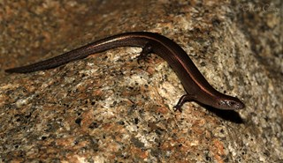
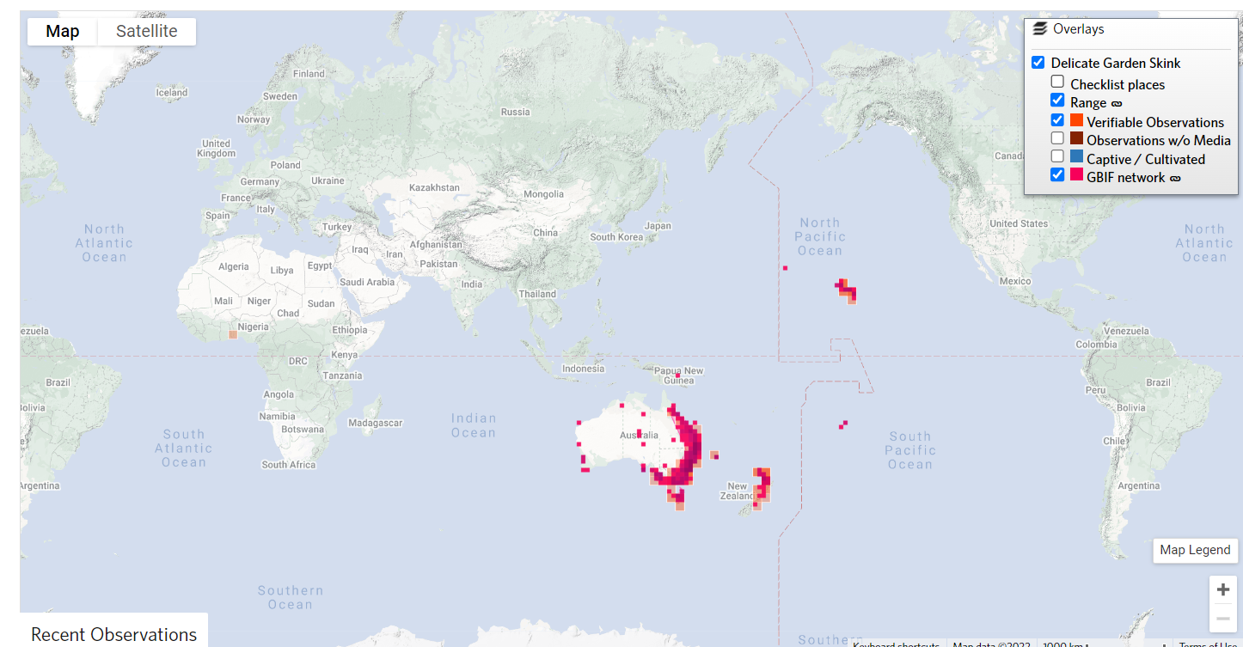
Rainbow skink*
Lampopholis delicata
KEY FEATURES
Rainbow skinks are 3-4cm long from the tip of the nose to back legs, excluding the long thin tail.
They are brown or grey-brown with a dark brown stripe down each side. A narrow yellowish-brown stripe is usually present on the outer edge of the back. The species can also have two distinct forms: one has a prominent white stripe and a less prominent white stripe
The skink has an shiny, rainbow, or metallic sheen, when seen in bright light.
Plague skinks lay many eggs, with communal nests of 20-100 small white eggs, 8-10 mm long, oval in shape. The eggs have a tough leathery shell. It is common to lay their eggs in the soil of potted plants
PATHWAYS ✓ shipping/machinery ✓ potted plants

Slide 2






Rainbow skink*
Lampropholis delicata
IMPACTS
Environment
Health
Society &
Culture
Economy
Reaches high abundances relatively quickly. Out-compete and exclude native lizard species. Prey on native invertebrates (insects)
None reported
None reported
None reported
DISTRIBUTION
Native range Eastern Australia and Tasmania
Introduced range Well established in New Zealand in the north of both islands. Introduced to Hawai’i. Reported from Cook Islands and Papua New Guinea (iNaturalist)
ADDITIONAL NOTES
* Also called Plague skink in New Zealand an delicate garden skink in Australia
INFORMATION SOURCES (click links for more)
Text and images Greater Wellington Regional council, Wikipedia, New Zealand Department of Conservation
Map iNaturalist

