Slide 1
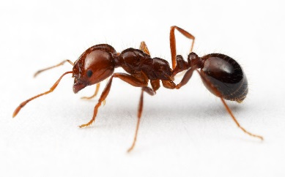
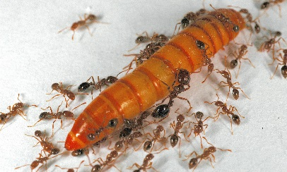
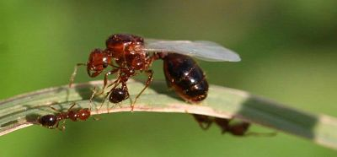
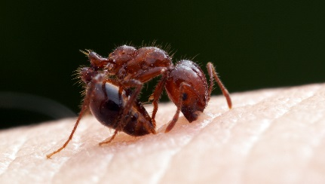
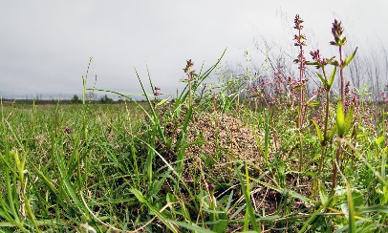
RED IMPORTED FIRE ANT
These ants will cause harm to you, your crops and your environment. If you find any of these ants, contact your local biosecurity/quarantine
STOP THIS INVADER
IN THE PACIFIC
Solenopsis invicta
Size: 2-6mm
bites
stings
harms
crops
harms
people
harms
wildlife
lives on
ground
day
active
different
sizes
© www.alexanderwild.com
What they look like
reddish-brown body, black abdomen
very aggressive and sting many times when disturbed
workers (the ants you see) in many sizes 2-6 mm long
queens (live in the nest) are much larger than workers
new queens have wings and are sometimes seen outside
builds mounds up to 40 cm high with no visible entrance
Sometimes mounds are small
Problems they cause
kill small animals like crabs, birds & lizards
painful sting can cause allergic reaction
reduce agricultural productivity
make it difficult to farm (stinging)
mounds interfere with farm equipment
hard to eradicate (get rid of)
Where they live
build mounds in places like
gardens, parks
fields, pastures
beaches
How they travel
hidden in
wooden containers
soil, compost, mulch, sand, gravel
rubbish
machinery, vehicles
© Johnny N. Dell BugwoodWiki
© www.alexanderwild.com
© www.alexanderwild.com

