Slide 1
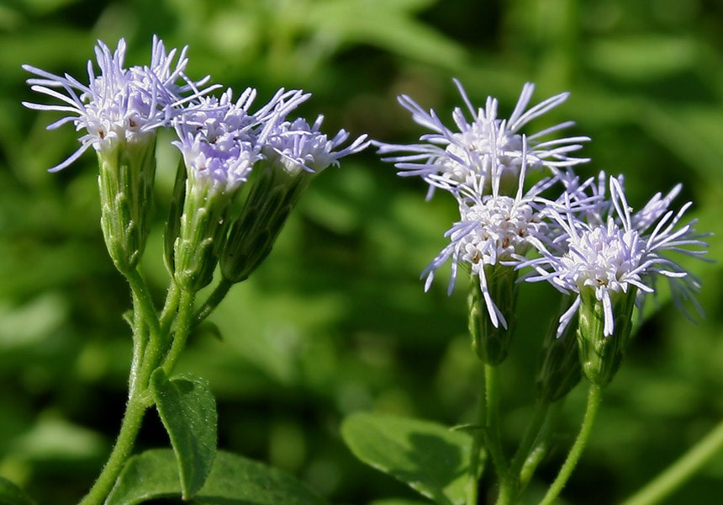
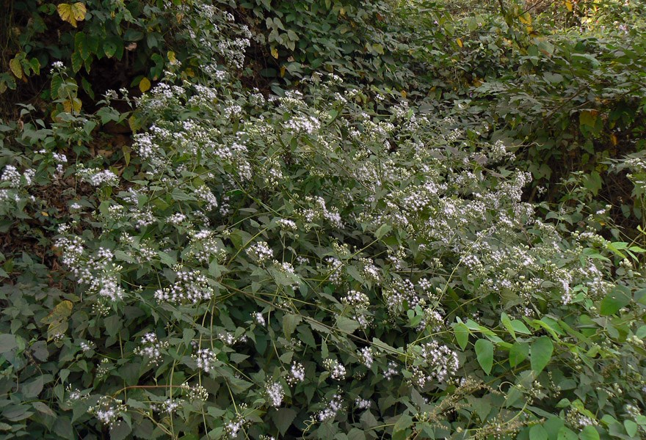
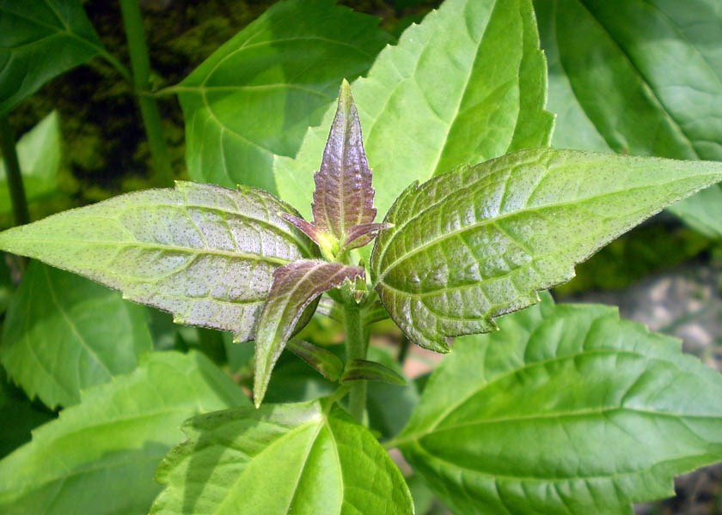
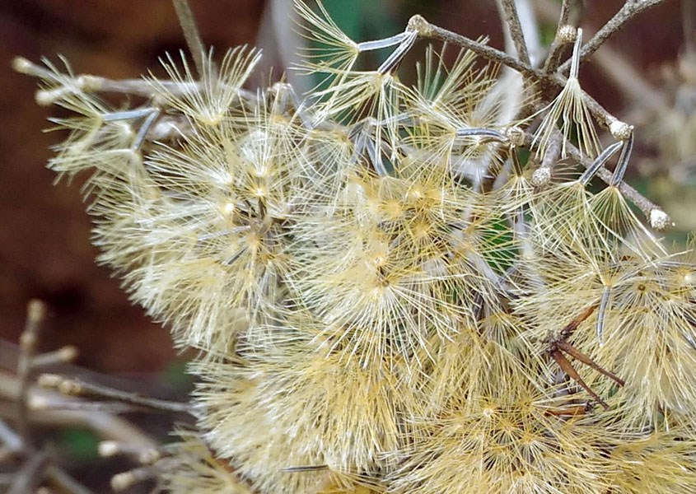
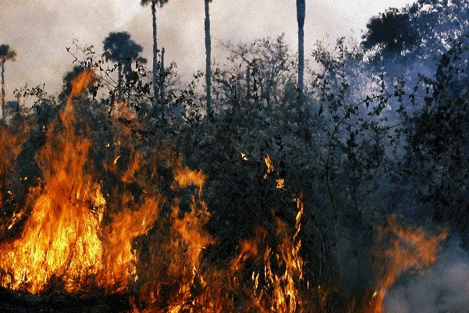
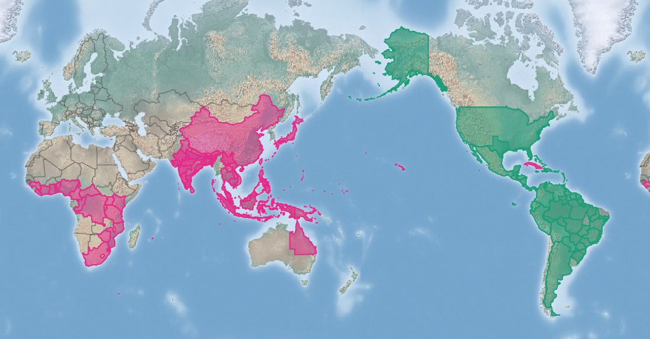
Siam weed
Chromoleana odorata
KEY FEATURES
Shrub with a bushy habit which forms a very dense thicket about 2 m high, excluding most other plants. Will climb on a support
When growing alone, plants start to branch when they reach a height of about 120 cm
Leaves are diamond to oval shape with a pointed tip and wedge-shaped base and serrated edges. Leaves and twigs smell when crushed
The flower colour ranges from pale-lilac to white
Each plant produces about 80,000 to 90,000 seeds, mostly spread by the wind, but can also cling to fur, clothes and machinery, enabling long distance dispersal
Volatile oils in the leaves make it a fire hazard
Can completely cover pastures and forest margins, excluding native species and low-growing crops including coffee and cocoa
PATHWAYS ✓ shipping ✓ machinery/vehicles ✓ seed contaminant
Introduced
Native
Origin not
recorded

Slide 2






Siam weed
Chromoleana odorata
IMPACTS
Environment
Health
Society &
Culture
Economy
Depending on the length and the intensity of the dry season, represents a serious fire hazard to natural vegetation
Can transmit disease-causing fungi
Uncontrolled fires can destroy plantations and villages
Smothers low-growing crops like coffee and cocoa. Replaces pasture species. Poisonous to cattle. Acts as a host for insect pests. In regions where there are dry seasons can be a fire hazard
DISTRIBUTION
Native range often noted as native to tropical Central and South America from Mexico and the Caribbean to Brazil, the exact limits of the native range are uncertain
Introduced range much of southern Africa, eastern Asia, northern Australia and Cuba
ADDITIONAL NOTES
INFORMATION SOURCES (click links for more)
Images (left to right, top to bottom) © J.M. Garg/via CABI and Wikipedia - CC BY 3.0, © Dinesh Valke/via CABI and flickr - CC BY-SA 2.0, Public Domain - Released by Ashasathees/via CABI and Wikipedia - CC 0, © Vijayan Rajapuram (Vijayanrajapuram)/via CABI and Wikipedia - CC BY-SA 4.0, © Laurent Gautier
Text and map Chromoleana odorata (Siam weed) – CABI https://www.cabi.org/isc/datasheet/23248 Wikipedia https://en.wikipedia.org/wiki/Chromolaena_odorata

