Slide 1
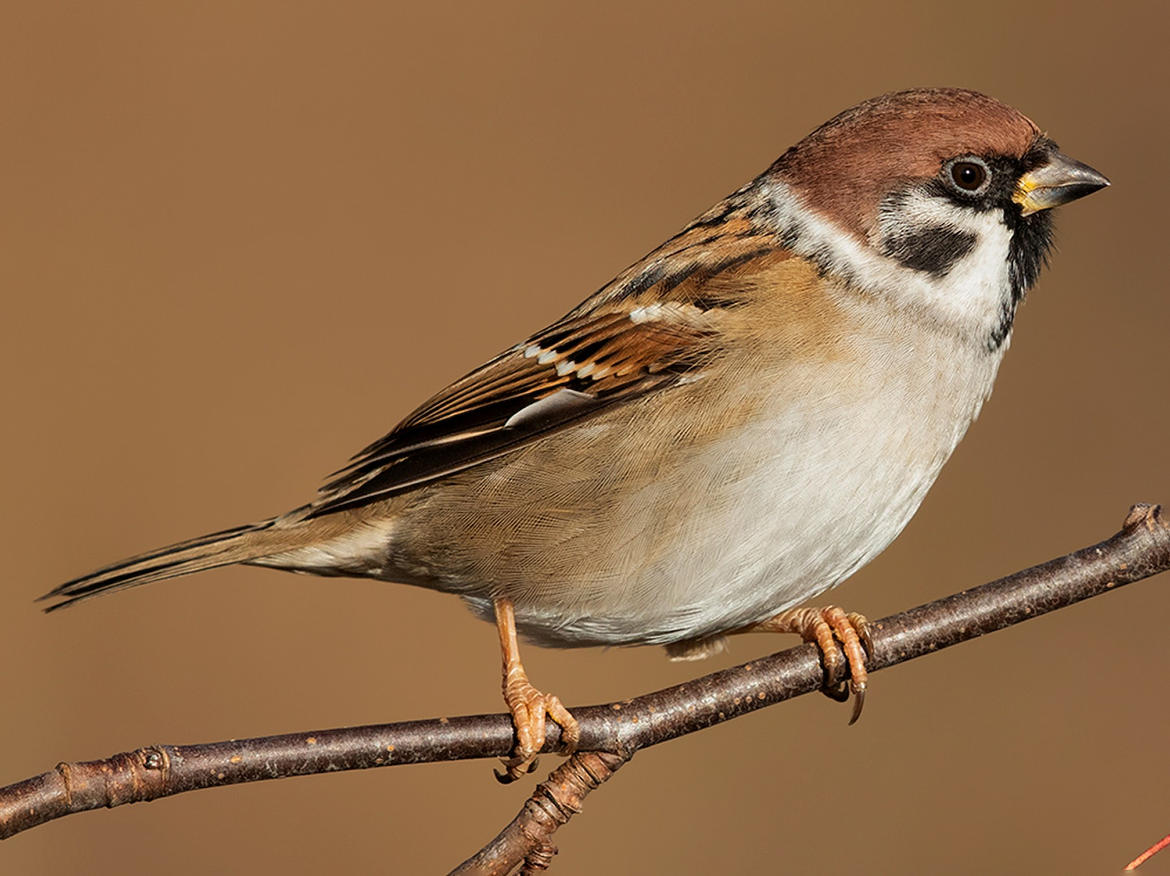
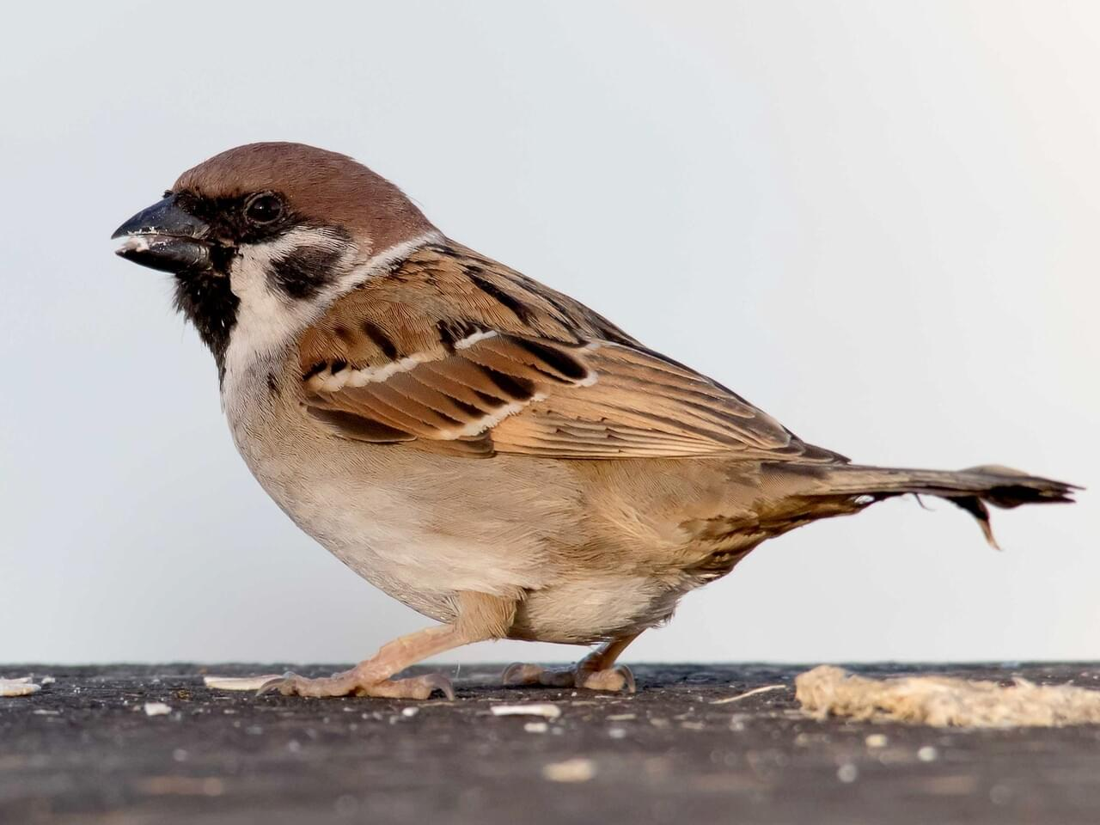
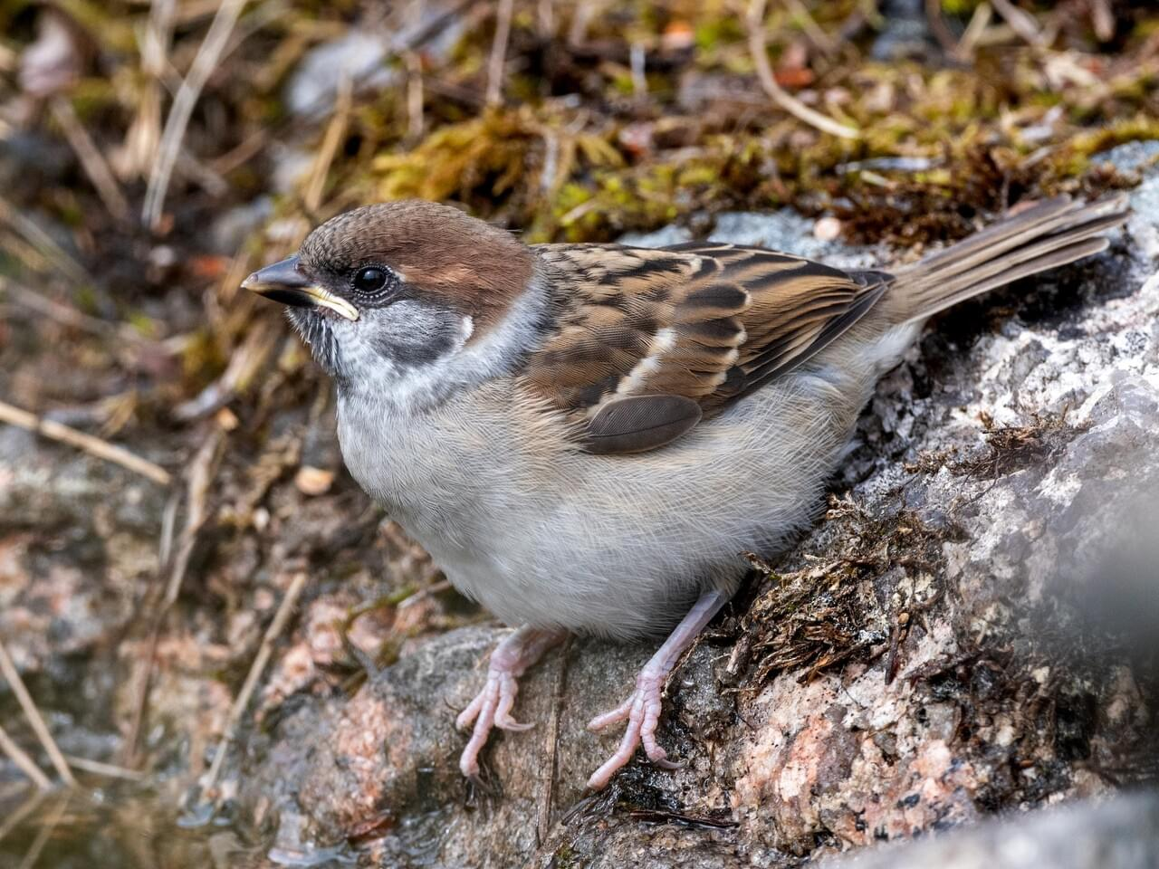
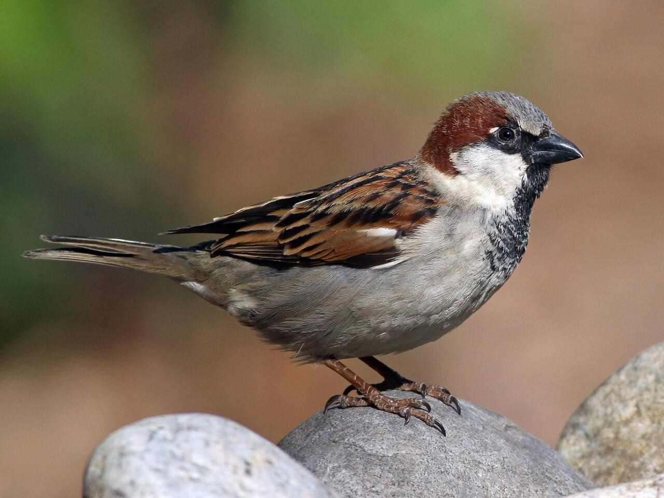
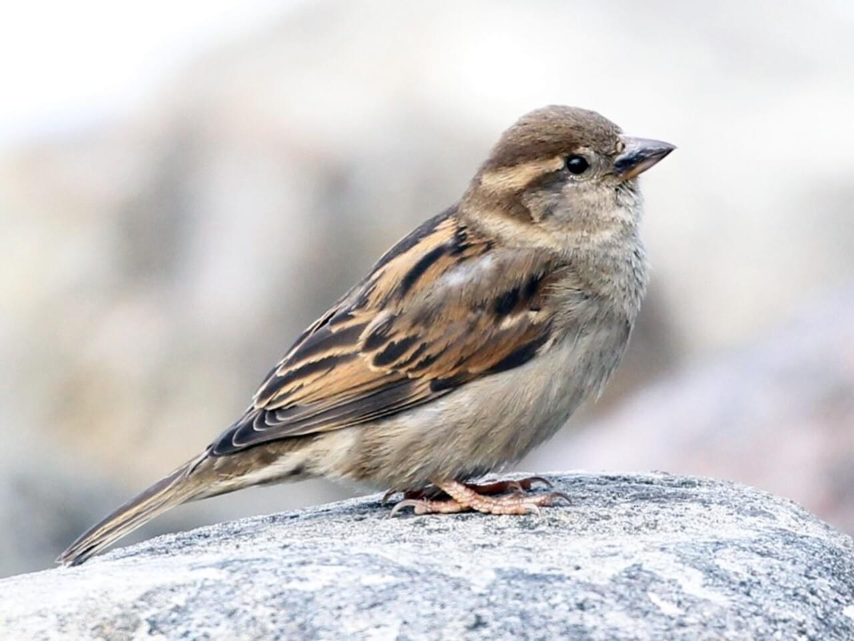
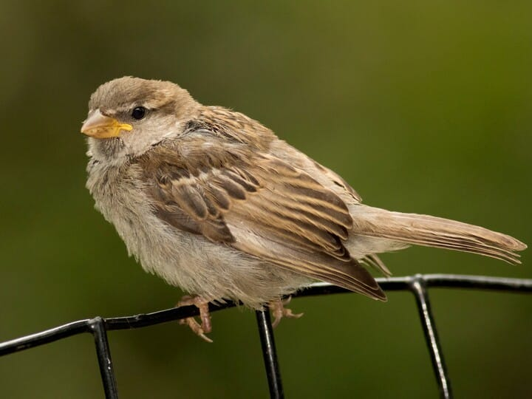
Eurasian tree sparrow and House sparrow
Passer montanus and Passer domesticus*
KEY FEATURES
Eurasian tree sparrow
House sparrow
Male Female Juvenile (young)
Eurasian tree sparrow measure 12-14 cm with an average mass of 24 g. House sparrows are on average slightly larger, with a length of 14-18 cm and mass of 24-40 g
Both male and female Eurasian tree sparrows have facial markings (white cheek with black ear patch), which are paler in young birds
House sparrow males have face markings but females and young do not have face markings
House sparrows are found in cities, towns, villages, and farms (particularly around animals). They are not found in bush, forests, or grasslands
Eurasian tree sparrows have similar habitat preferences to House sparrows. They also need nest cavities such as crevices in old buildings, fence posts, or holes in trees
Both species eat seeds, and House sparrows will also eat plants and insects
House and Eurasian tree sparrows both have a generally broad distribution except in the driest and coldest areas
Eurasian tree sparrow are made up of seven subspecies with only slight differences among them. At least 15 other subspecies have been proposed, but they are considered to be intermediates of the seven subspecies
House sparrow’s global spread has been attributed to its close association with people
PATHWAYS ✓ ships ✓ intentional introductions

Slide 2






Eurasian tree sparrow and House sparrow
Passer montanus and Passer domesticus*
IMPACTS
Environment
Health
Society &
Culture
Economy
Compete with native birds, eat native insects, but could also be able to control introduced insects
Not reported, although large numbers of birds roosting on roofs can potentially contaminate water supplies
Not reported, but impacts on native plants and animals will have flow-on impacts if these species are of cultural importance
Not widely reported, but reports of severe crop damage in the Marshall Islands
DISTRIBUTION
Native range
Eurasian tree sparrow Most of temperate Europe and Asia south of about latitude 68°N and throughout Southeast Asia to Java and Bali
House sparrow Originated in the Middle East and spread naturally to most of Eurasia and parts of North Africa
Introduced range
Eurasian tree sparrow Sardinia, eastern Indonesia, the Philippines and Micronesia, Borneo, parts of North America, parts of Australia
House sparrow Much of the world, including most of North America, Bermuda, Central America, southern South America, southern Africa, part of West Africa, Iceland and Rishiri Island, Japan, Australia, New Zealand, and islands throughout the world. The most widely distributed wild bird on the planet
ADDITIONAL NOTES
Both species are reported as invasive. Eurasian tree sparrows have been displaced by the later arrival of house sparrows in several locations. Neither species is listed in CABI.
INFORMATION SOURCES (click links for more)
Images and text All about birds website: https://www.allaboutbirds.org/guide/Eurasian_Tree_Sparrow/id https://www.allaboutbirds.org/guide/House_Sparrow/id Wikipedia entries: https://en.wikipedia.org/wiki/Eurasian_tree_sparrow https://en.wikipedia.org/wiki/House_sparrow

