Slide 1
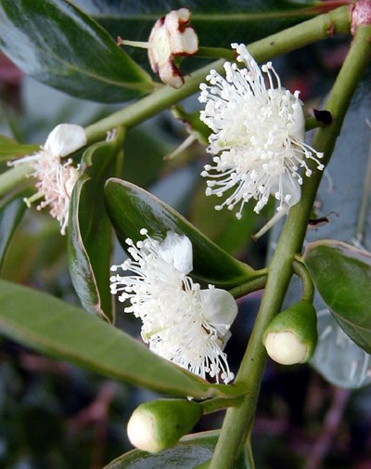
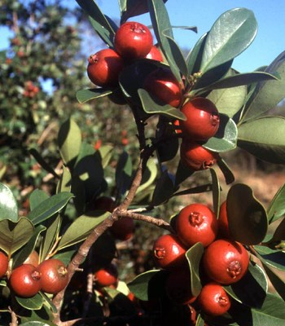
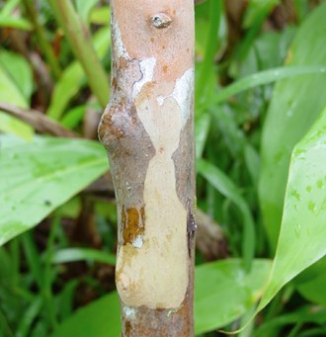
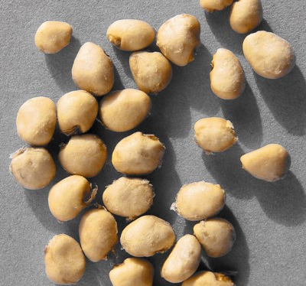
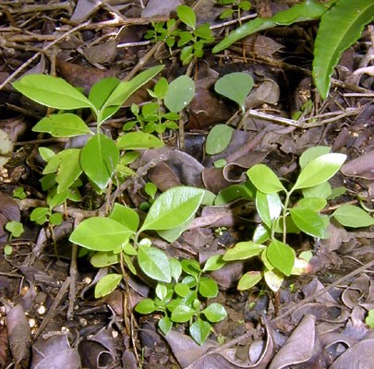
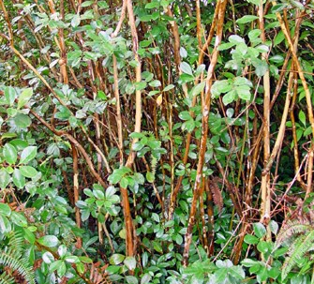
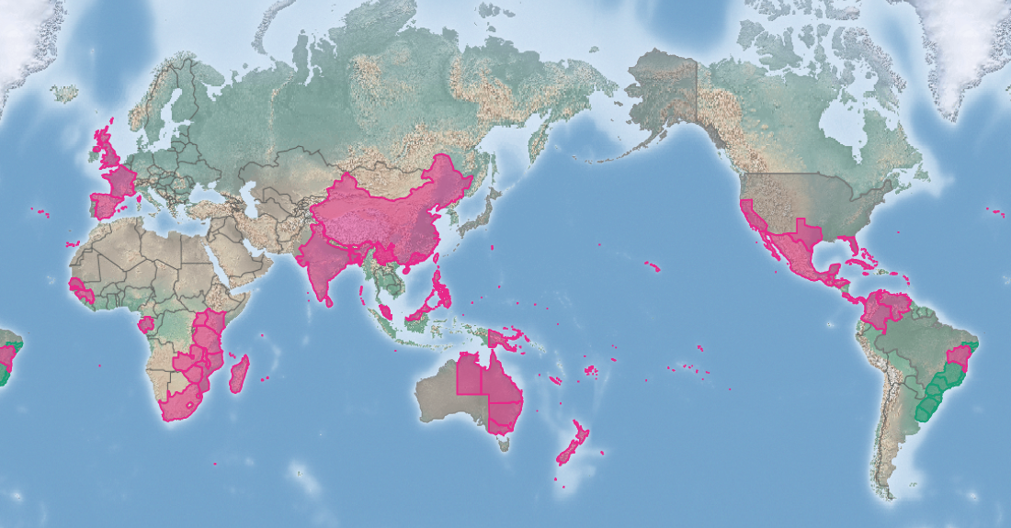
Strawberry guava
Psidium cattleianum
KEY FEATURES
Introduced widely as an ornamental
Displaces native plants and threatens their survival and ecosystem resilience
Spread through mail-order websites or seed catalogues
Reproduces easily by seeds and suckers. Seeds spread down slopes, along river edges, dispersed after being eaten by mammals (feral pigs, rodents, monkeys) and fruit-eating birds
Flowers fragrant, usually single, rarely grouped in 2-3. Four-five white petals are rounded, 5–6 mm diameter. Many stamens, and a greenish disc-shaped stigma
Fruit is round-oval, 1.5-4 cm diameter. Unripe skin is dark green, ripening to red-purple or sulfur-yellow
Pulp is soft, whitish with 2-100 seeds. Seeds are 2-3 mm long, and yellowish
Stem and branches are smooth, pinkish, greenish or greyish brown. Bark peels off in small papery flakes
Young leaves and twigs are red becoming glossy, waxy and green
See additional notes for growth habit
PATHWAYS ✓ shipping ✓ horticulture ✓ mail-order seeds
Introduced
Native
Origin not
recorded

Slide 2






Strawberry guava
Psidium cattleianum
IMPACTS
Environment
Health
Society &
Culture
Economy
Disrupts native ecosystems, reducing natural resilience. Particularly harmful in fragile island rainforests that provide habitats for endemic species. Considered the most serious invader in Hawai’i rainforests, Réunion and Mauritius
Not reported
Not reported
Can be used as a fruit crop, but benefits outweighed impacts as it can invade pastures and is a host for several fruit fly species
DISTRIBUTION
Native range native to south-east Brazil and northern Uruguay
Introduced range widespread throughout the tropics and subtropics and naturalized almost everywhere it has been introduced, particularly in rainforests and on island ecosystems in the Indian and Pacific Ocean
ADDITIONAL NOTES
The form of the trees depends on the environment. In full sunlight, it is a slow growing evergreen shrub, 2-4 m tall and often branching from the base with an overall round shape. Under shaded conditions it is straight and branches weakly and can reach 8 m tall
INFORMATION SOURCES (click links for more)
Images © Frédéric Normand, via CABI
Text and map Psydium cattleianum (Strawberry guava) – CABI https://www.cabi.org/isc/datasheet/45135

