Slide 1
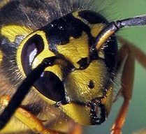
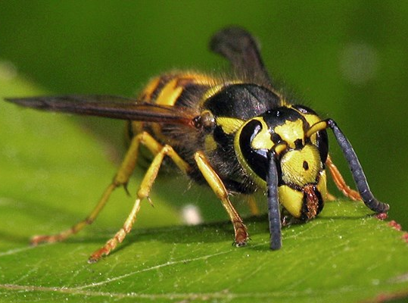
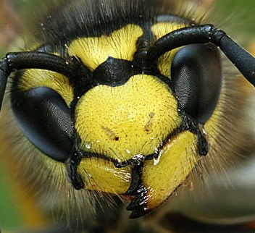
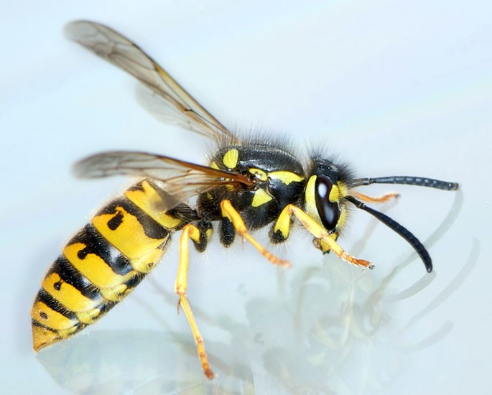
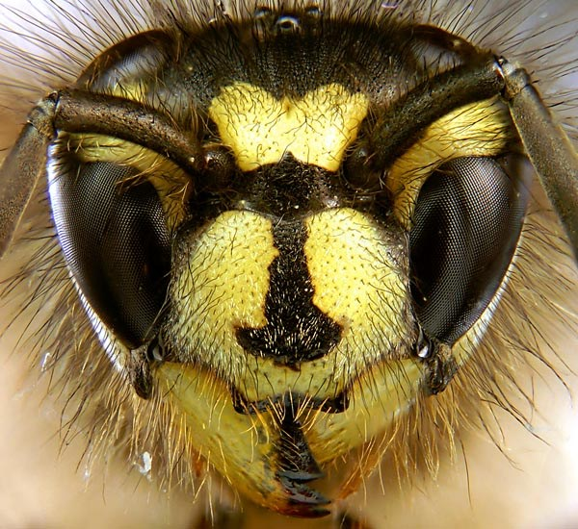
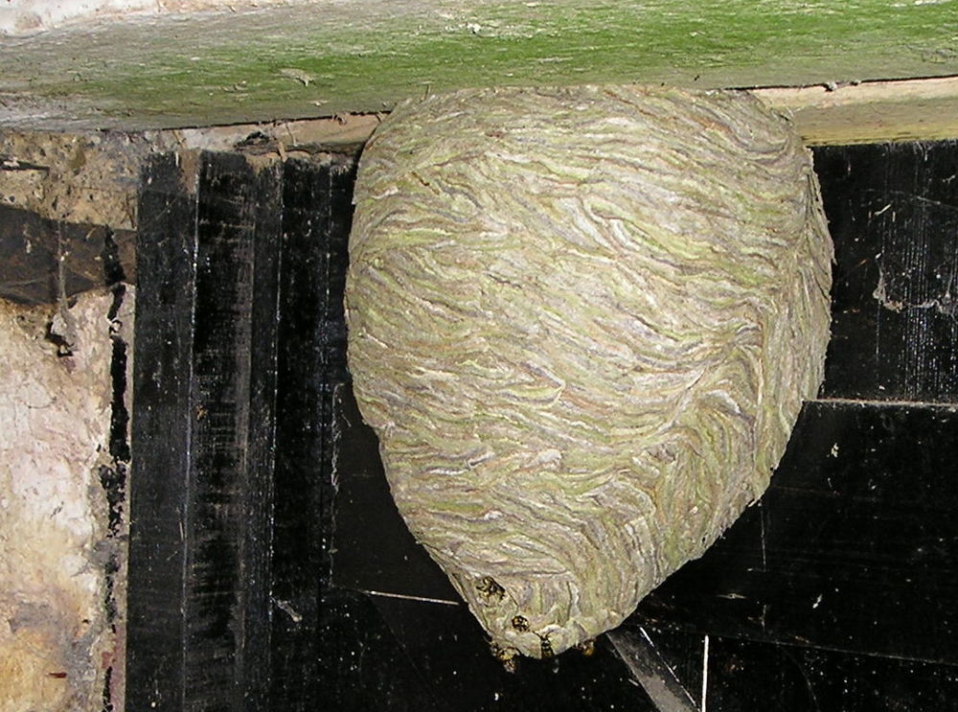
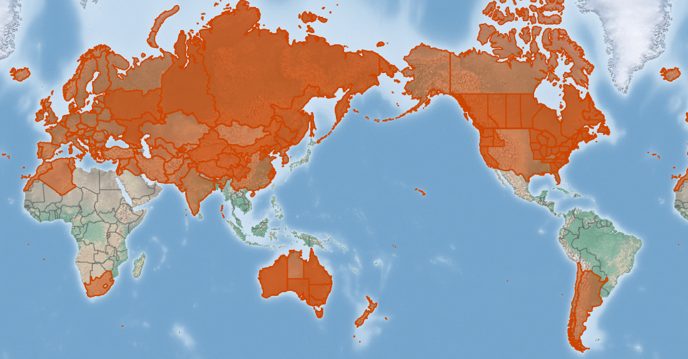
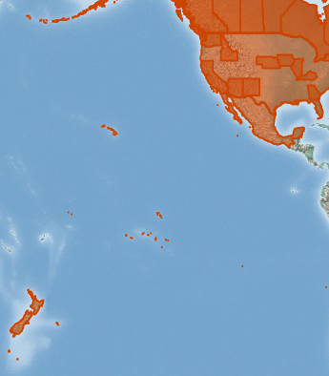
Wasps/yellowjackets
Vespula spp*
KEY FEATURES
Western yellowjacket
German wasp
Common wasp
Known as yellowjackets in north America and wasps elsewhere, Vespula have similar impacts, habitats and pathways
All wasps are predators and will eat almost anything
Common wasp has a distinctive “anchor” down the centre of the face
All have high potential for dispersal and colonization of new territories, particularly via shipping, planes and road vehicles
Wasps have a life history that includes a hibernating, adult female able to establish a new colony alone. These “queens”, which usually stay in the nest, are larger (~ 20 mm) than the “worker” wasps (~10-15 mm – images on left) that are commonly seen
Build nests (image on left) underground or hidden away behind retaining walls and rockeries in gardens, in cavity walls or roof spaces in buildings and abandoned burrows of rodents or rabbits. Sometimes build an exposed nest
PATHWAYS ✓ shipping ✓ timber/forestry ✓ machinery
Present

Slide 2






Vespid wasps
Vespula spp*
IMPACTS
Environment
Health
Society &
Culture
Economy
Can kill virtually all insect life in a local, causing loss of insect-eating birds, insect pollinators of rare or endangered flowers. Adversely affects the breeding success of birds, and kill baby birds
Are very aggressive, and can sting many times. Can cause allergic reaction, anaphylaxis and occasional deaths have been reported
Affect quality of life by hindering outdoor activities, especially eating outdoors, and could cause declines of plants traditionally used or make their harvesting hazardous
Wasps can have significant negative impacts on horticulture, apiculture (beekeeping), tourism, and animal health. Can cause loss of half of some fruit crops
DISTRIBUTION
Ranges All of Europe, Iceland, most of continental Asia, United States, Canada, most of Mexico, Hawai‘i (Kaua‘i, O‘ahu, Maui, Moloka‘i and Hawai‘i), Argentina, Chile, Australia, New Zealand, South Africa, parts of northern Africa and the Middle East
ADDITIONAL NOTES
* This factsheet describes three closely related species, the common wasp (Vespula vulgaris), the western yellowjacket (Vespula pensylvanica) and German wasp (Vespula germanica). They have similar impacts and look similar. As their native and introduced ranges all differ, the entire range of all species is described here
INFORMATION SOURCES (click links for more)
Images Western yellowjacket © Werner Eigelsreiter, German wasp Public Domain - Released by Bernie Kohl/via wikipedia - CC0, Common wasp © Timothy Evison www.scientificillustration.net - CC BY-SA 2.5, all via CABI
Text and map Vespula germanica (German wasp) – CABI https://www.cabi.org/isc/datasheet/56667 Vespula vulgaris (common wasp) – CABI https://www.cabi.org/isc/datasheet/56675 Vespula pensylvanica (western yellowjacket) – CABI https://www.cabi.org/isc/datasheet/56670

