Slide 1
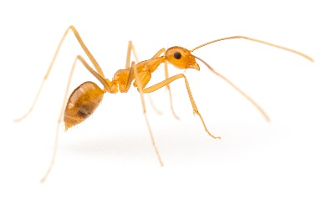
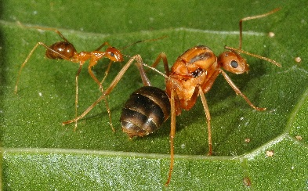
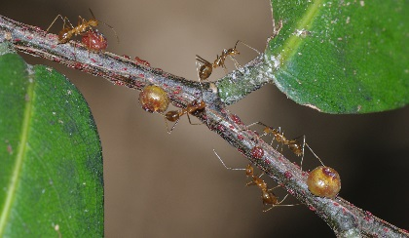
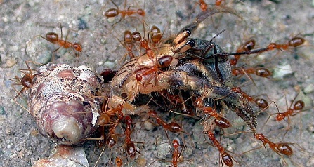
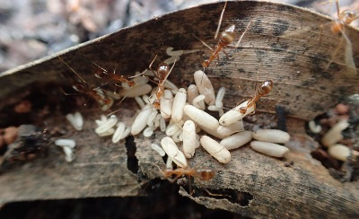
YELLOW CRAZY ANT
These ants will cause harm to you, your crops and your environment. If you find any of these ants, contact your local biosecurity/quarantine
STOP THIS INVADER
IN THE PACIFIC
Anoplolepis gracilipes
Size: 5mm
sprays acid
harms
crops
harms
people
harms
wildlife
lives in
trees
lives on
ground
night
active
day
active
© www.alexanderwild.com
© Phil Lester
What they look like
movement is fast and erratic – “crazy”
long legs and antennae
yellowish brown body
workers 3-5 mm long
queens are much larger and bulkier than workers
Problems they cause
kill small animals like crabs, birds & lizards
sprays acid, annoys people at home and work
farms other insects that damage crops and trees
Where they live
build nests in and under places like
cracks in buildings
leaves, rocks and wood
rubbish piles
crab burrows
machinery
roots of trees
decaying coconuts
firewood piles
How they travel
hidden in
fruit and other food
building containers
plants and soil
rubbish
firewood
machinery
vehicles
© Phil Lester
© Pete Green
© Kirsti Abbott
© Meghan Cooling
Notes:
Example: This is a version of the Yellow crazy ant poster intended to be printed A4 size.

Slide 2
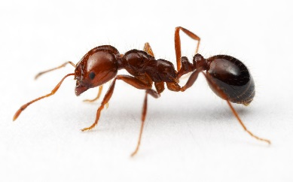
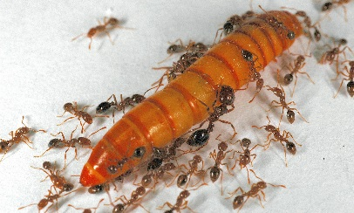
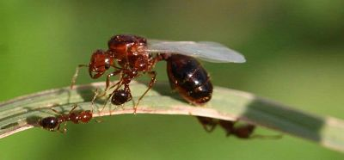
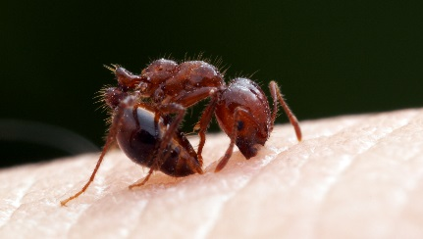
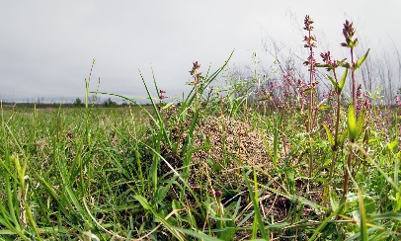
RED IMPORTED FIRE ANT
These ants will cause harm to you, your crops and your environment. If you find any of these ants, contact your local biosecurity/quarantine
STOP THIS INVADER
IN THE PACIFIC
Solenopsis invicta
Size: 2-6mm
bites
stings
harms
crops
harms
people
harms
wildlife
lives on
ground
day
active
different
sizes
© www.alexanderwild.com
What they look like
reddish-brown body, black abdomen
very aggressive and sting many times when disturbed
workers (the ants you see) in many sizes 2-6 mm long
queens (live in the nest) are much larger than workers
new queens have wings and are sometimes seen outside
builds mounds up to 40 cm high with no visible entrance
Sometimes mounds are small
Problems they cause
kill small animals like crabs, birds & lizards
painful sting can cause allergic reaction
reduce agricultural productivity
make it difficult to farm (stinging)
mounds interfere with farm equipment
hard to eradicate (get rid of)
Where they live
build mounds in places like
gardens, parks
fields, pastures
beaches
How they travel
hidden in
wooden containers
soil, compost, mulch, sand, gravel
rubbish
machinery, vehicles
© Johnny N. Dell BugwoodWiki
© www.alexanderwild.com
© www.alexanderwild.com

Slide 3
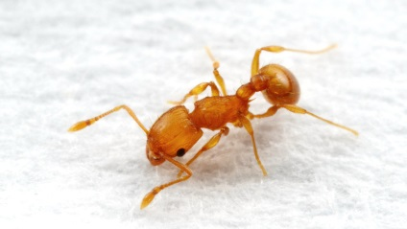
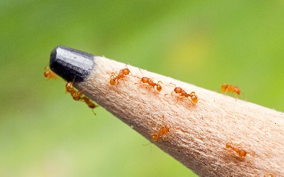
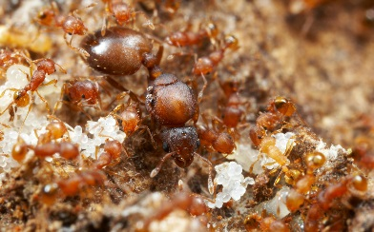
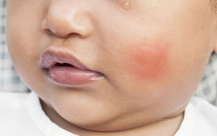
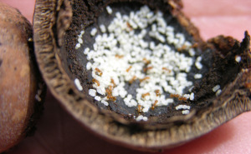
These ants will cause harm to you, your crops and your environment. If you find any of these ants, contact your local biosecurity/quarantine
LITTLE FIRE ANT
STOP THIS INVADER
IN THE PACIFIC
Wasmannia auropunctata
Size: 1.5mm
stings
harms
crops
harms
people
harms
wildlife
lives on
ground
lives in trees
day
active
© www.alexanderwild.com
What they look like
tiny, look like moving dots
light orange body
slow moving
workers (the ants you see) fall from trees like “stinging rain”
workers 1.5 mm long
Queens (live in nests) are much larger than workers
Problems they cause
kill small animals like crabs, birds &lizards
painful sting that causes an itchy rash
can blind domestic animals
can affect people’s vision if stung in the eye (clouded cornea)
make it difficult to farm (stinging)
in high densities they make land uninhabitable
Where they live
build nests in and around places like
cracks in buildings
bedding and furniture
rocks, leaves and twigs
trees (including high branches) and shrubs
decaying nuts (e.g. macadamia, coconut)
How they travel
hidden in
fruit and other food
plants
soil, mulch and compost
luggage
decaying nuts (e.g. macadamia, coconut)
© www.alexanderwild.com
© www.alexanderwild.com
© www.alexanderwild.com
© Panya Kuanun/Shutterstock
© Hawai’I Department of Agriculture
Notes:
Example: This is a version of the Little fire ant poster intended to be printed A4 size.

